Slide 1
Ch.4 Software
BIT 1003 – Presentation 7

Slide 2
Contents
GENERATIONS OF LANGUAGES
COMPILERS AND INTERPRETERS
VIRTUAL MACHINES
OBJECT-ORIENTED PROGRAMMING
SCRIPTING LANGUAGES
FUNCTIONAL LANGUAGES
LANGUAGE DESIGN
LANGUAGE SYNTAX AND SEMANTICS

Slide 3
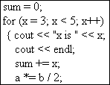

COMPILERS AND INTERPRETERS
Program
(high-level)
Machine code
COMPILER

Slide 4
VIRTUAL MACHINES
A virtual machine such as the Java JVM is a computer defined by software rather than hardware.
A virtual machine runs programs like a real computer, but the virtual machine is really another program, a construction in software, that fetches, decodes, and executes the program’s instructions. The instructions are referred to as bytecode

Slide 5
PROCEDURAL PROGRAMMING
For many new programmers, procedural programming is the natural paradigm.
A program can often be conceived simply as a list of instructions to be executed in order; that is, a procedure to be followed by the computer.
Procedural programming languages are also called imperative languages.

Slide 6
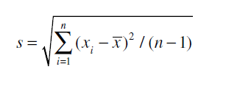
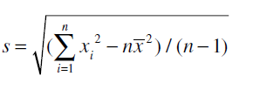
Example: calculation of standard deviation (sd) of an array of numbers
s | : | sample standard deviation
 | : | is the sample mean
n | : | array dimension (number of scores in array)
 | : | array of numbers (scores)
An equivalent formula often useful for computation is the following:

Slide 7
(cont.) pseudocode
Set SUM and SUMSQUARES equal to 0.0
Set n = size of the array of scores
Start with the first score, and continue until all the scores have been processed
Set SUM = SUM + score
Set SUMSQUARES = SUMSQUARES + score²
End of loop
Set MEAN = SUM/n
Return the SquareRoot of (SUMSQUARES − n * MEAN ²) / (n − 1)

Slide 8
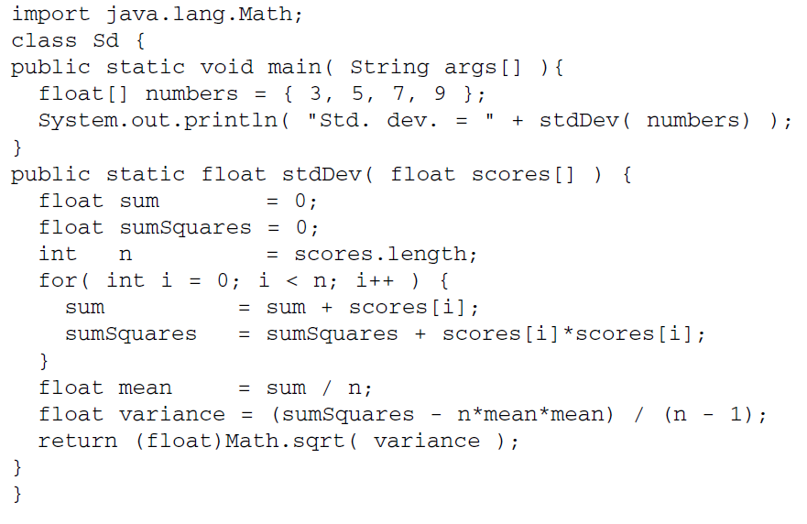
(cont.) java program for sd calc.

Slide 9
OBJECT-ORIENTED PROGRAMMING
Object-oriented (OO) programming is a more recent development that provides approaches that further advance software reliability and reuse.
That often allow the software to “fit” better with our understanding of the real world that our programs may be reacting to, or trying to control.

Slide 10
Object
attributes
(instance variables)
methods

Slide 11
e.g.
car
attributes
color
horsepower
speed
methods
changeSpeed()
park()
refuel()

Slide 12
Properties of OOp
encapsulation
  Programs wishing to use the code of an object can access that code only through public instance variables and public instance methods.
inheritance
  it’s helpful to take advantage of the earlier code by creating a new class that inherits from the old, and simply adds the new features.
polymorphism
  polymorphism means that the execution of a method of a given name may be different depending on the class of the object for which the method is invoked.

Slide 13
limousine object inherits attributes and methods of car object
car
attributes
color
horsepower
speed
methods
changeSpeed()
park()
refuel()
limousine
attributes
cost
beverages on board
schedule
methods
currentCoord()
path()

Slide 14
SCRIPTING LANGUAGES
Today there is a large set of programming languages collectively referred to as scripting languages.
The original idea of a “script” was a set of operating system commands placed in a file.
When a user “executes” the script file, the set of commands in the file is executed in order.
This notion of a script is still heavily used.
Scripts are very useful for automating routine tasks which otherwise would require a person to sit at a keyboard and type the same commands again and again.

Slide 15
For text processing, for example, the languages awk, sed, and Perl are popular.
Perl has also become popular for general-purpose programming, and the languages PHP, Ruby, and Python are other languages useful for larger applications.

Slide 16
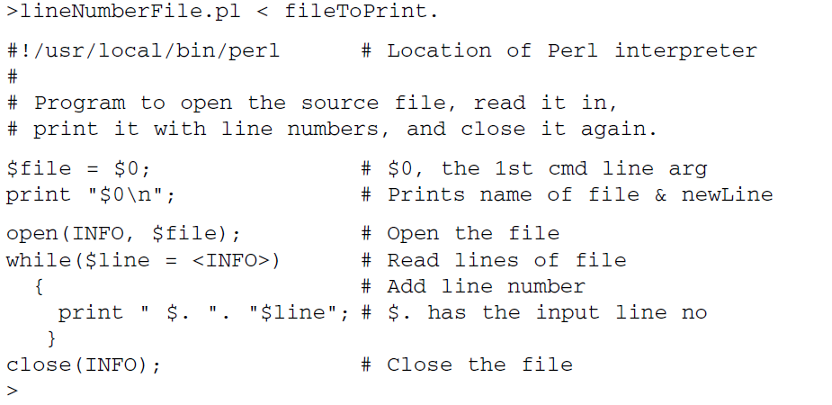
lineNumberFile.pl

Slide 17


FUNCTIONAL LANGUAGES
Functional languages represent computing as solving mathematical functions.
A function takes one or more arguments, and returns a value.
  For example, an equation for a parabola is:
  for x=3

Slide 19
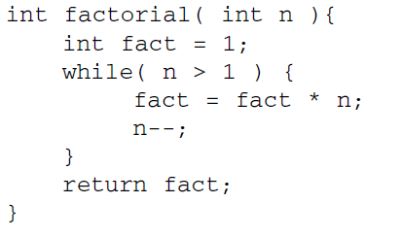
factorial calculation in C

Slide 20
SUMMARY
The machine instruction sets themselves constituted the first generation programming languages.
Assembly languages, using mnemonic character strings to represent machine instructions, made up the second generation of programming languages.
Beginning with FORTRAN in 1954, third-generation languages allowed programmers to work at a higher level,

Slide 21
SUMMARY
Programs can be compiled or interpreted. Compilers generate machine instructions that can run directly on the computer.
Interpreters are programs that read and execute source code a line at a time.
Java is an environment that uses both.

Slide 22
SUMMARY
Some languages are described as imperative, and of these we discussed procedural, object-oriented, and scripting languages.
Other languages are described as declarative, and of these we discussed functional languages.

Slide 23
REVIEW QUESTIONS:
4.1 -4.3

