Slide 1
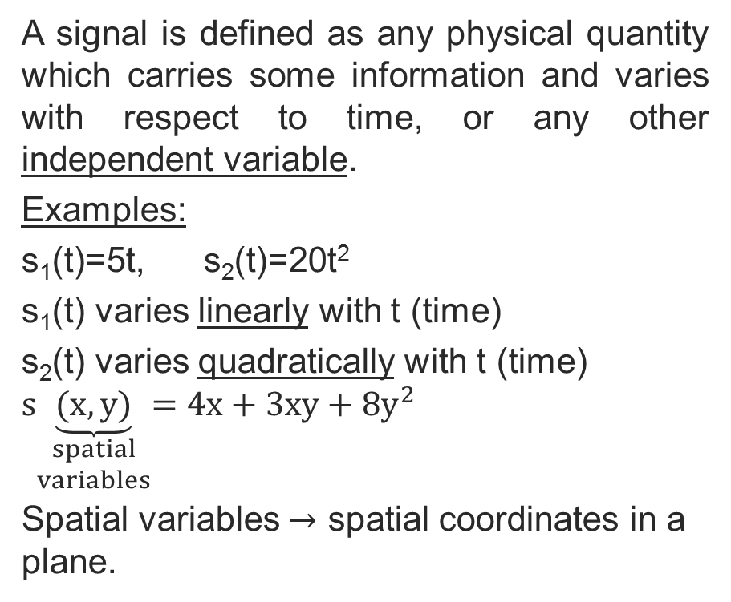
What is the Signal?
A signal is defined as any physical quantity which carries some information and varies with respect to time, or any other independent variable.
Examples:
s₁(t)=5t, s₂(t)=20t²
s₁(t) varies linearly with t (time)
s₂(t) varies quadratically with t (time)
$$s\underset{\begin{aligned}spatial \\ variables\end{aligned}}{\underbrace{(x, y)}}=4x+3xy+8y^{2}$$
Spatial variables $→$ spatial coordinates in a plane.
Copyright 2012 | Instructor: Dr. Gülden Köktürk | EED1004-INTRODUCTION TO SIGNAL PROCESSING

Slide 2
A signal with a single independent variable is called one-dimensional.
A signal with M independent variables is called M-dimensional.
Example: A black-and white-TV picture is a 3-dimensional signal. What are its independent variables?
Signals can be classified into 4 categories based on the characteristics of the independent variable(s) and the values they take.
Copyright 2012 | Instructor: Dr. Gülden Köktürk | EED1004-INTRODUCTION TO SIGNAL PROCESSING

Slide 3
Continuous-time and continuous-valued signals (analog signals)
(Both horizontal and vertical axes are continuous)
Example: Speech signals, radar signals, geophysical signals, biomedical signals of electrocardiogram (ECG)
p=f(t)
Discrete-time, continuous-valued signals
These types of signals are obtained by sampling analog signals.
Copyright 2012 | Instructor: Dr. Gülden Köktürk | EED1004-INTRODUCTION TO SIGNAL PROCESSING

Slide 4
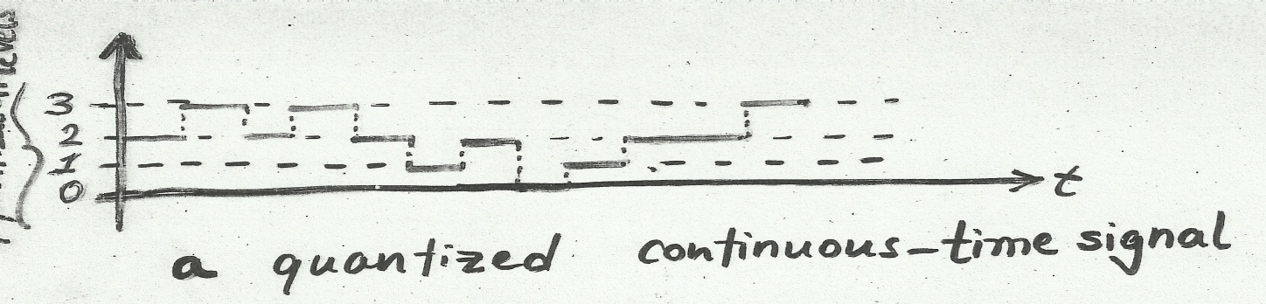
Sampling is the discretization of the horizontal axis.
Continuous-time, discrete-valued signals
These types of signals are obtained by quantization of analog signals.
Quantization is the discretization of the vertical axis.
Copyright 2012 | Instructor: Dr. Gülden Köktürk | EED1004-INTRODUCTION TO SIGNAL PROCESSING

Slide 5
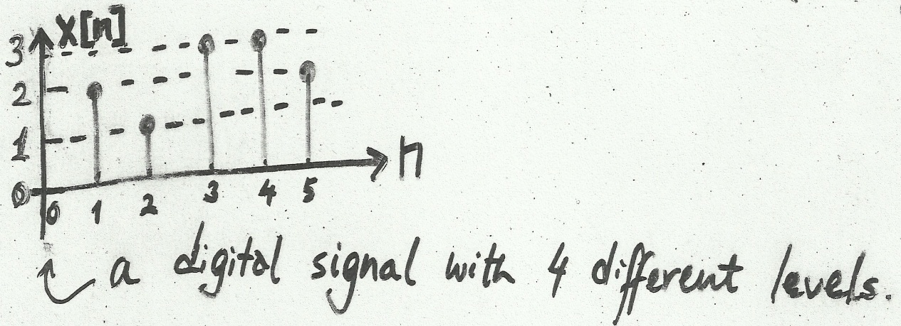

Example: A black-and-white photograph
$\begin{matrix}+1:white \\ −1:black\end{matrix}$ $\begin{matrix}\begin{aligned}y=f\underset{spatial variables}{(\underbrace{x_{1}, x_{2})}} \\ \left\{−1, +1\right\} \end{aligned} \\ \end{matrix}$
Discrete-time, discrete-valued signals (digital signals)
Digital signals are required for computers.
Copyright 2012 | Instructor: Dr. Gülden Köktürk | EED1004-INTRODUCTION TO SIGNAL PROCESSING

Slide 6
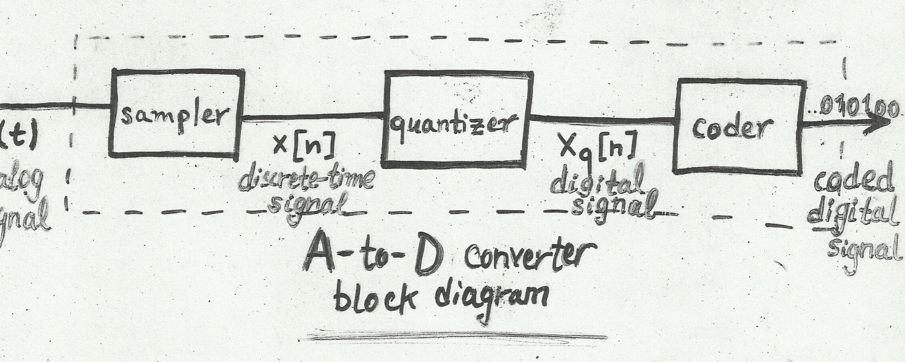
Copyright 2012 | Instructor: Dr. Gülden Köktürk | EED1004-INTRODUCTION TO SIGNAL PROCESSING

Slide 7
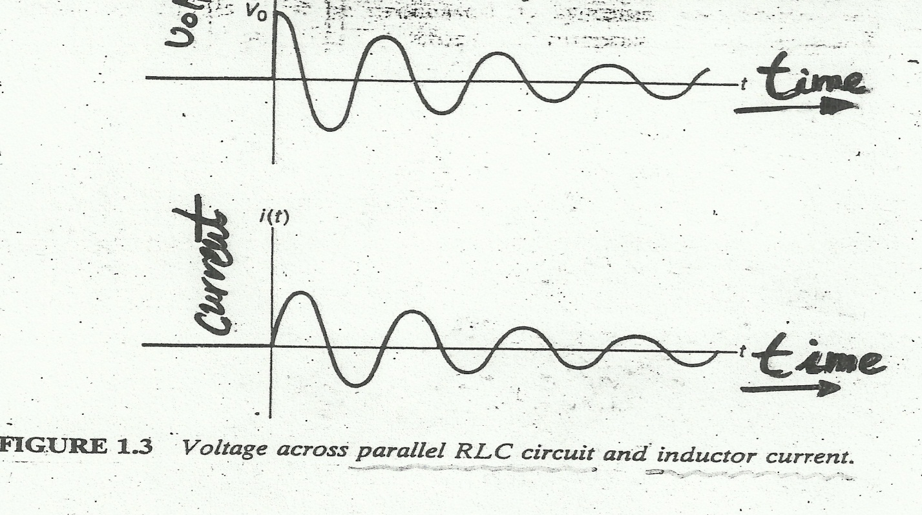
EXAMPLES OF CONTINUOUS SIGNALS (ANALOG SIGNALS)
İnfo: at time t=0 charged to V₀ volts
Copyright 2012 | Instructor: Dr. Gülden Köktürk | EED1004-INTRODUCTION TO SIGNAL PROCESSING

Slide 8
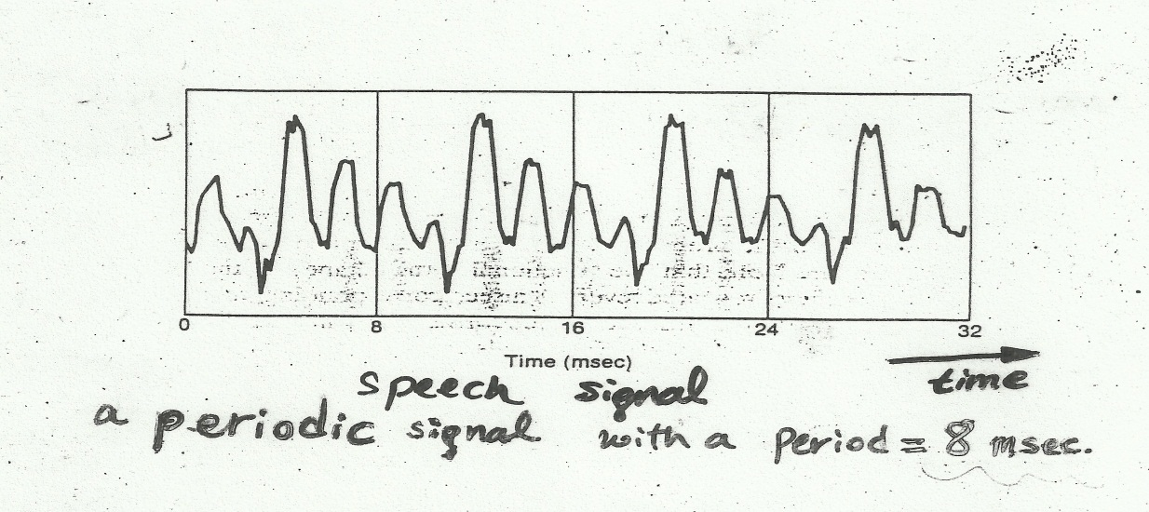
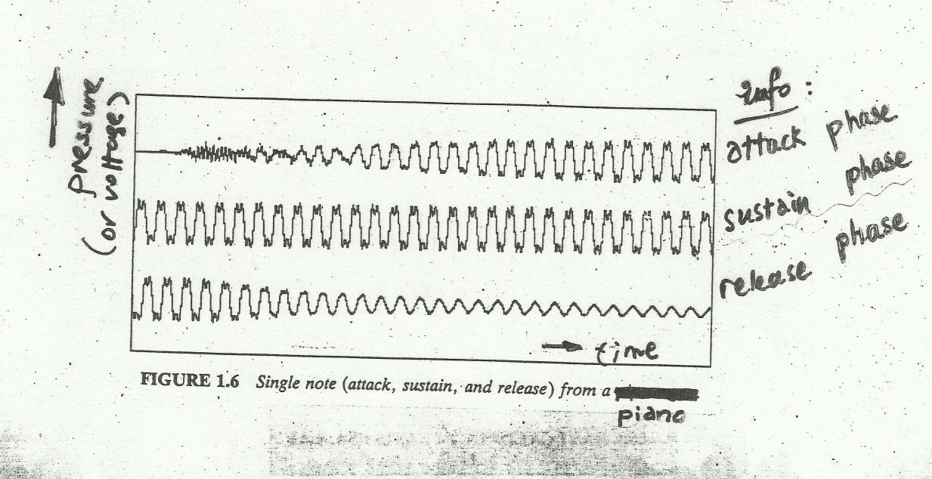
Copyright 2012 | Instructor: Dr. Gülden Köktürk | EED1004-INTRODUCTION TO SIGNAL PROCESSING

Slide 9
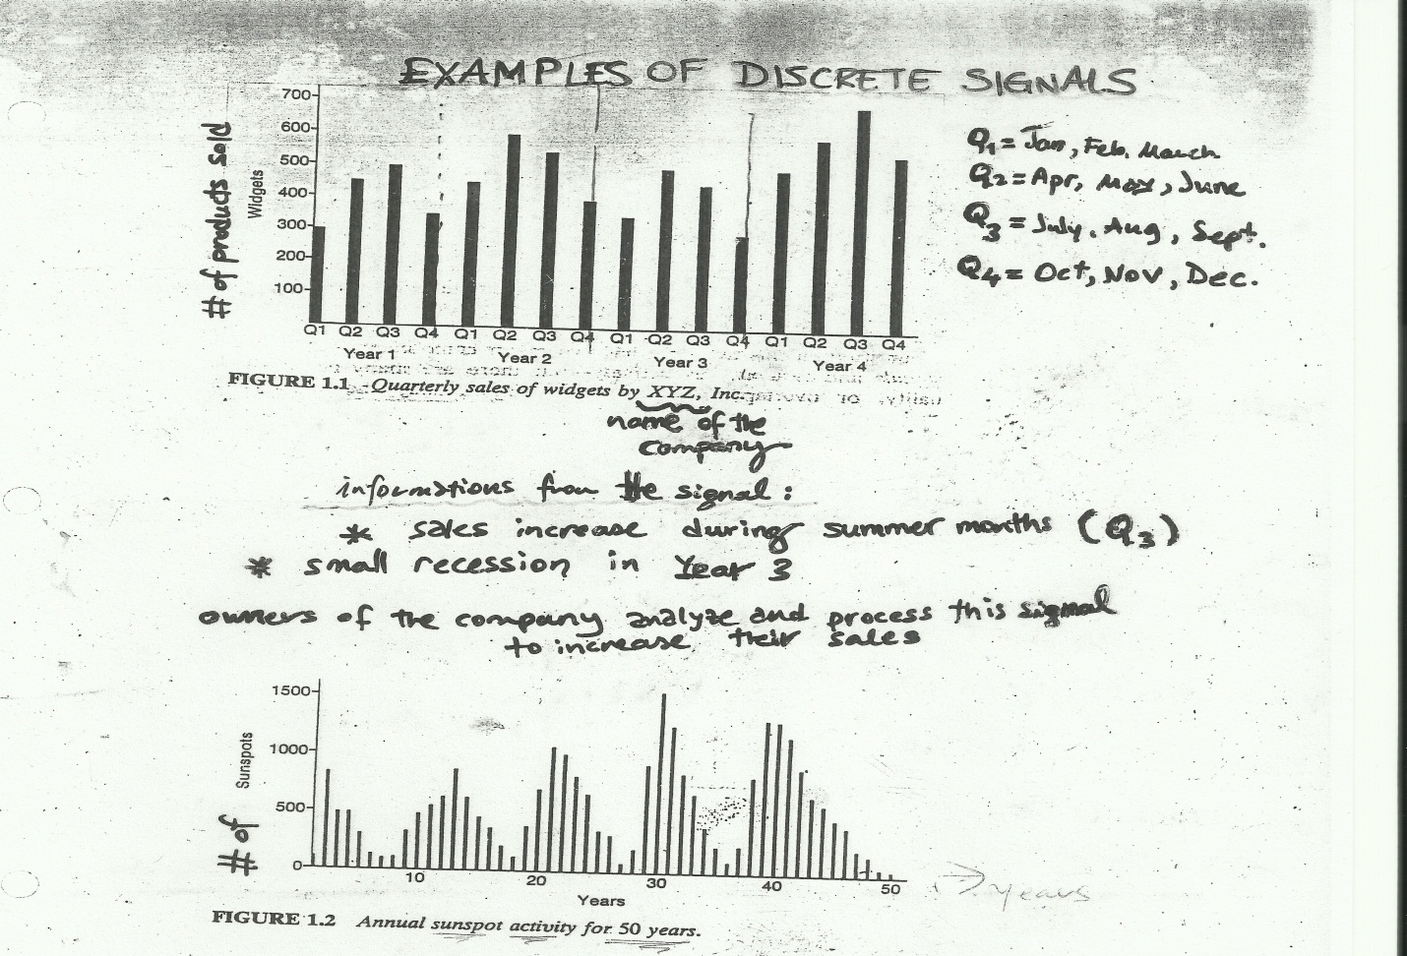
Information: approximate period of 11 years
Copyright 2012 | Instructor: Dr. Gülden Köktürk | EED1004-INTRODUCTION TO SIGNAL PROCESSING

