Slide 1
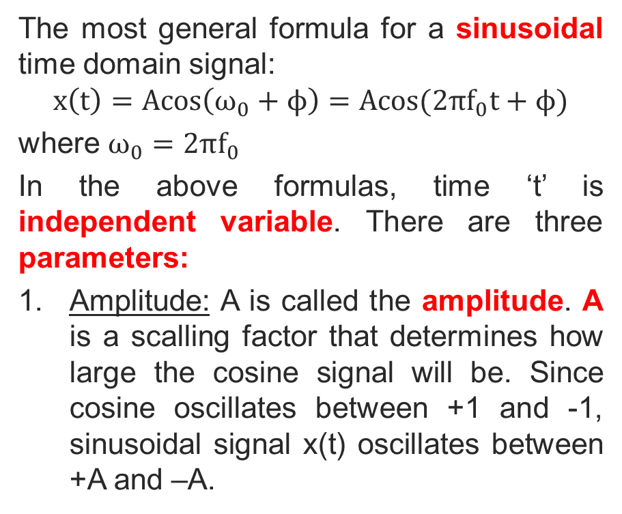
CONTINUOUS-TIME SINUSOIDAL SIGNALS
The most general formula for a sinusoidal time domain signal:
$$x\left(t\right)=Acos\left(ω_{0}+ϕ\right)=Acos(2πf_{0}t+ϕ)$$
where $ω_{0}=2πf_{0}$
In the above formulas, time ‘t’ is independent variable. There are three parameters:
Amplitude: A is called the amplitude. A is a scalling factor that determines how large the cosine signal will be. Since cosine oscillates between +1 and -1, sinusoidal signal x(t) oscillates between +A and –A.
Copyright 2012 | Instructor: Dr. Gülden Köktürk | EED1004-INTRODUCTION TO SIGNAL PROCESSING

Slide 2
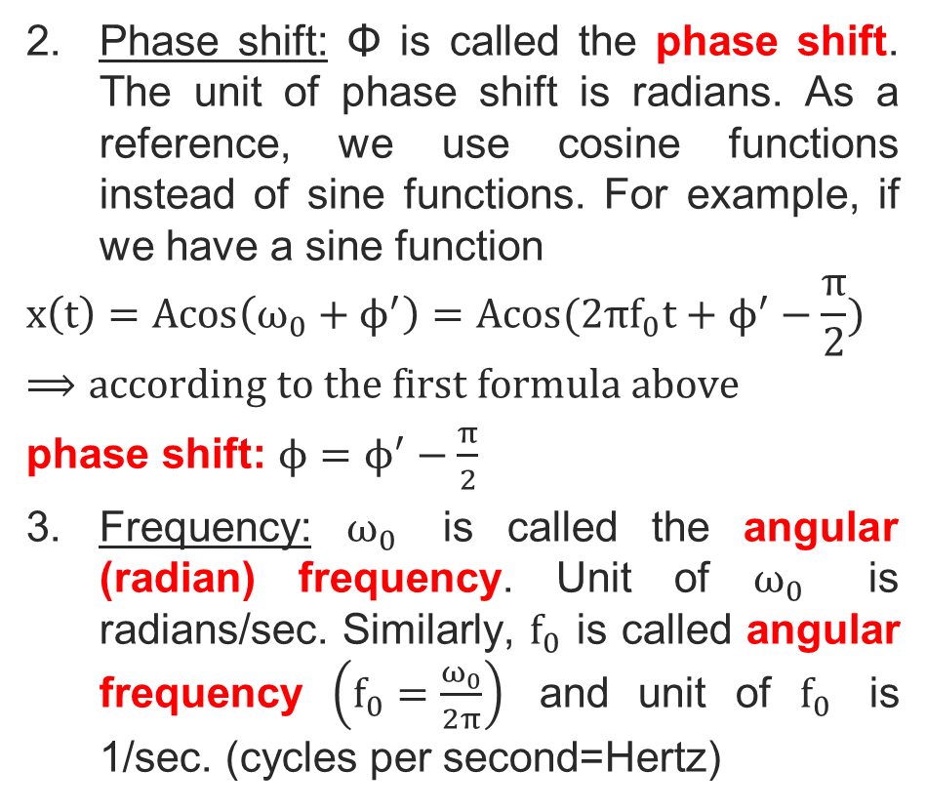
Phase shift: Φ is called the phase shift. The unit of phase shift is radians. As a reference, we use cosine functions instead of sine functions. For example, if we have a sine function
$$x\left(t\right)=Acos\left(ω_{0}+ϕ^{′}\right)=Acos(2πf_{0}t+ϕ^{′}−\frac{π}{2})$$
$$⟹according to the first formula above$$
phase shift: $ϕ=ϕ^{′}−\frac{π}{2}$
Frequency: $ω_{0}$ is called the angular (radian) frequency. Unit of $ω_{0}$ is radians/sec. Similarly, $f_{0}$ is called angular frequency $\left(f_{0}=\frac{ω_{0}}{2π}\right)$ and unit of $f_{0}$ is 1/sec. (cycles per second=Hertz)
Copyright 2012 | Instructor: Dr. Gülden Köktürk | EED1004-INTRODUCTION TO SIGNAL PROCESSING

Slide 3
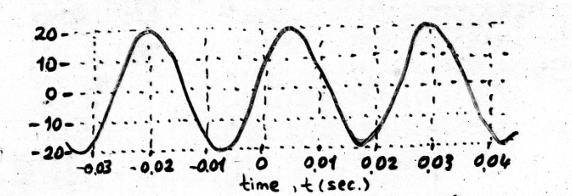

Example: x(t)=20cos(2π(40)t-0,4π)
$$⟹A=20, ω_{0}=2πf_{0}=2π\left(40\right),$$
$$f_{0}=40 and ϕ=−0,4π$$
A plot of this sinusoidal signal is seen above.
Copyright 2012 | Instructor: Dr. Gülden Köktürk | EED1004-INTRODUCTION TO SIGNAL PROCESSING

Slide 4
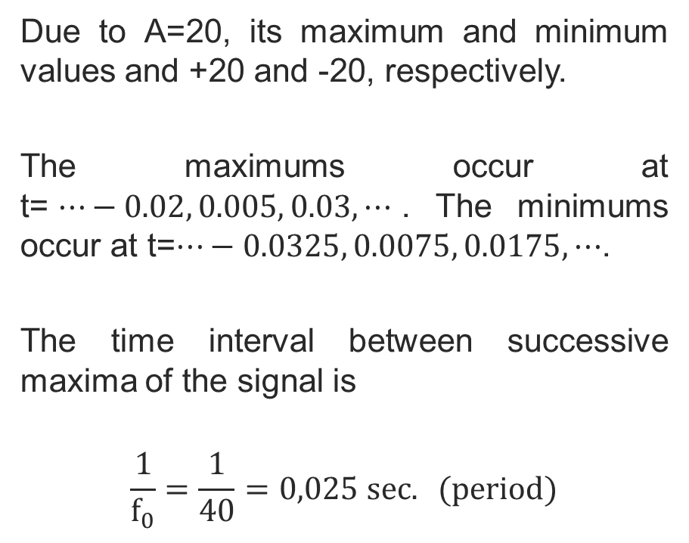
Due to A=20, its maximum and minimum values and +20 and -20, respectively.
The maximums occur at t=$⋯−0.02, 0.005, 0.03, ⋯$. The minimums occur at t=$⋯−0.0325, 0.0075, 0.0175, ⋯$.
The time interval between successive maxima of the signal is
$$\frac{1}{f_{0}}=\frac{1}{40}=0,025 sec. (period)$$
Copyright 2012 | Instructor: Dr. Gülden Köktürk | EED1004-INTRODUCTION TO SIGNAL PROCESSING

Slide 5
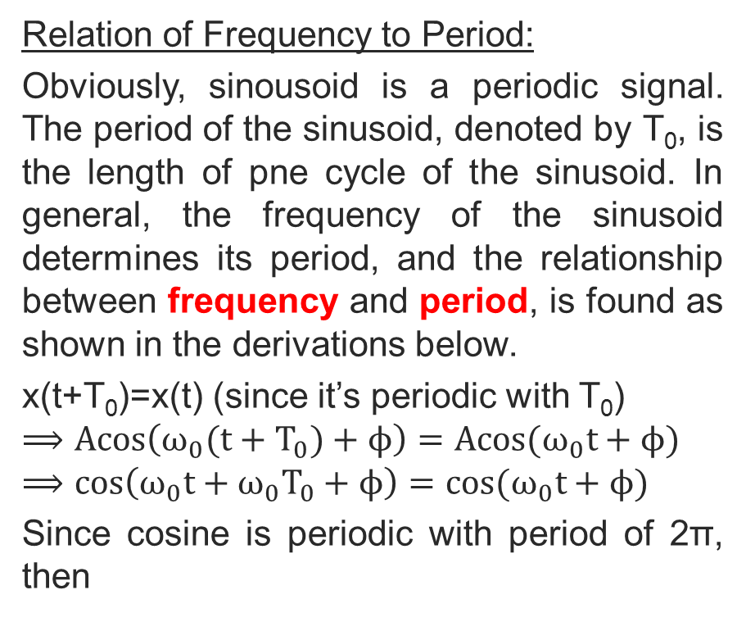
Relation of Frequency to Period:
Obviously, sinousoid is a periodic signal. The period of the sinusoid, denoted by T₀, is the length of pne cycle of the sinusoid. In general, the frequency of the sinusoid determines its period, and the relationship between frequency and period, is found as shown in the derivations below.
x(t+T₀)=x(t) (since it’s periodic with T₀)
$$⟹Acos\left(ω_{0}(t+T_{0})+ϕ\right)=Acos(ω_{0}t+ϕ)$$
$$⟹cos\left(ω_{0}t+{ω_{0}T}_{0}+ϕ\right)=cos(ω_{0}t+ϕ)$$
Since cosine is periodic with period of 2π, then
Copyright 2012 | Instructor: Dr. Gülden Köktürk | EED1004-INTRODUCTION TO SIGNAL PROCESSING

Slide 6
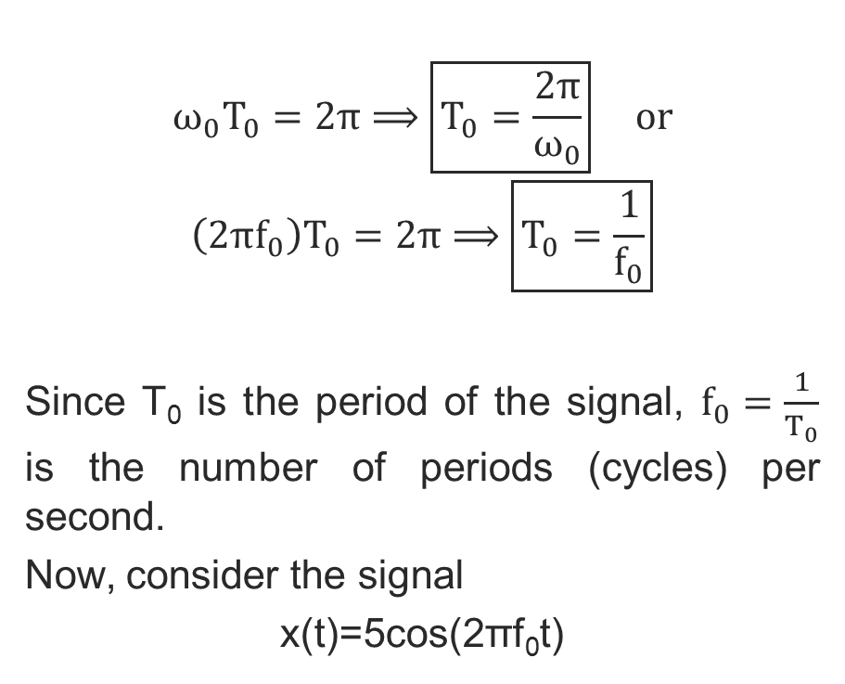
$$ω_{0}T_{0}=2π⟹\boxed{T_{0}=\frac{2π}{ω_{0}}} or$$
$$\left(2πf_{0}\right)T_{0}=2π⟹\boxed{T_{0}=\frac{1}{f_{0}}}$$
Since T₀ is the period of the signal, $f_{0}=\frac{1}{T_{0}}$ is the number of periods (cycles) per second.
Now, consider the signal
x(t)=5cos(2πf₀t)
Copyright 2012 | Instructor: Dr. Gülden Köktürk | EED1004-INTRODUCTION TO SIGNAL PROCESSING

Slide 7
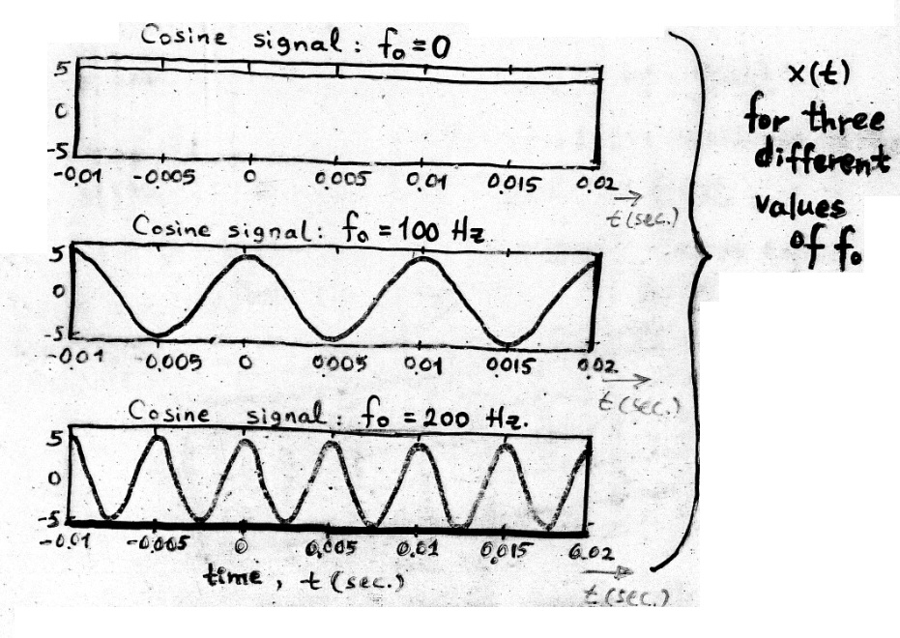
Copyright 2012 | Instructor: Dr. Gülden Köktürk | EED1004-INTRODUCTION TO SIGNAL PROCESSING

Slide 8
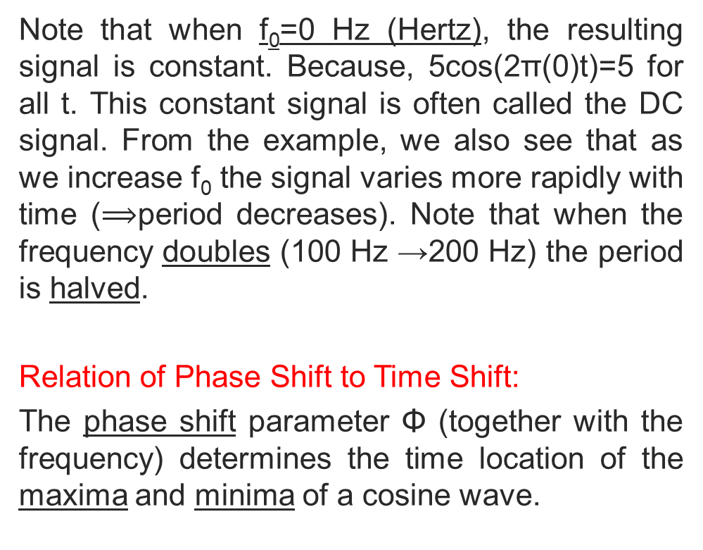
Note that when f₀=0 Hz (Hertz), the resulting signal is constant. Because, 5cos(2π(0)t)=5 for all t. This constant signal is often called the DC signal. From the example, we also see that as we increase f₀ the signal varies more rapidly with time ($⟹$period decreases). Note that when the frequency doubles (100 Hz →200 Hz) the period is halved.
Relation of Phase Shift to Time Shift:
The phase shift parameter Φ (together with the frequency) determines the time location of the maxima and minima of a cosine wave.
Copyright 2012 | Instructor: Dr. Gülden Köktürk | EED1004-INTRODUCTION TO SIGNAL PROCESSING

Slide 9
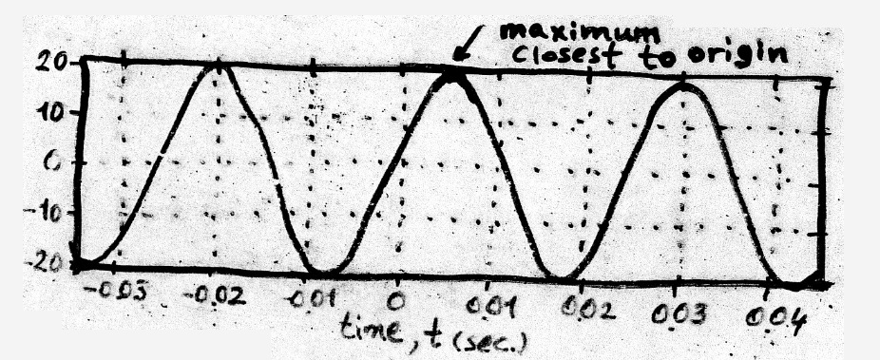

Recall the most general formula for sinusoid
$$x\left(t\right)=Acos(2πf_{0}t+ϕ)$$
If Φ=0, then x(t) has a maximum at t=0.
If Φ$≠0$, phase shift determines how much the maximum of the sinusoidal signal is shifted with respect to t=0.
One way to determine the time shift for a cosine signal would be to find the maximum of the sinusoid that is closest to t=0.
Copyright 2012 | Instructor: Dr. Gülden Köktürk | EED1004-INTRODUCTION TO SIGNAL PROCESSING

Slide 10
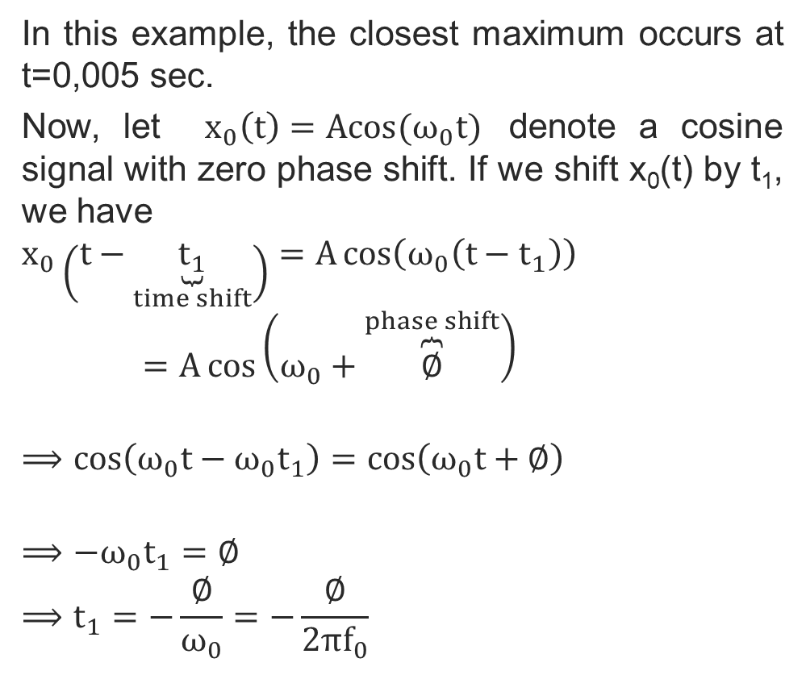
In this example, the closest maximum occurs at t=0,005 sec.
Now, let $x_{0}\left(t\right)=Acos(ω_{0}t)$ denote a cosine signal with zero phase shift. If we shift x₀(t) by t₁, we have
$$x_{0}\left(t−\underset{time shift}{\underbrace{t_{1}}}\right)=A\cos\left(ω_{0}\left(t−t_{1}\right)\right)=A\cos\left(ω_{0}+\overset{phase shift}{\overbrace{∅}}\right)$$
$$⟹\cos\left(ω_{0}t−ω_{0}t_{1}\right)=\cos\left(ω_{0}t+∅\right)$$
$$⟹−ω_{0}t_{1}{=∅}$$
$$⟹t_{1}{=−\frac{∅}{ω_{0}}=−\frac{∅}{2πf_{0}}}$$
Copyright 2012 | Instructor: Dr. Gülden Köktürk | EED1004-INTRODUCTION TO SIGNAL PROCESSING

Slide 11
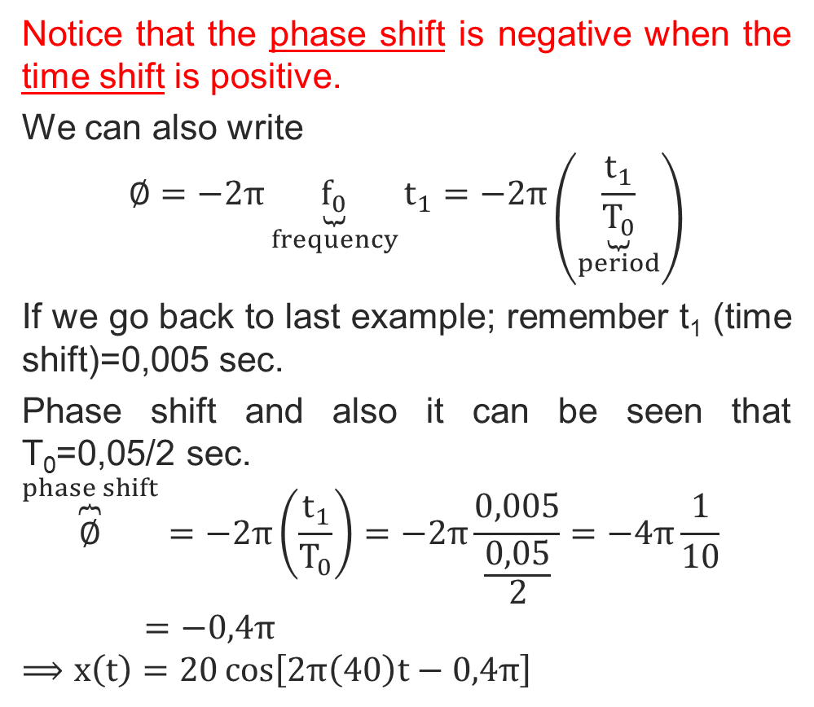
Notice that the phase shift is negative when the time shift is positive.
We can also write
$$∅=−2π\underset{frequency}{\underbrace{f_{0}}}t_{1}=−2π\left(\underset{period}{\underbrace{\frac{t_{1}}{T_{0}}}}\right)$$
If we go back to last example; remember t₁ (time shift)=0,005 sec.
Phase shift and also it can be seen that T₀=0,05/2 sec.
$$\overset{phase shift}{\overbrace{∅}}=−2π\left(\frac{t_{1}}{T_{0}}\right)=−2π\frac{0,005}{\frac{0,05}{2}}=−4π\frac{1}{10}=−0,4π$$
$$⟹x\left(t\right)=20\cos\left[2π\left(40\right)t−0,4π\right]$$
Copyright 2012 | Instructor: Dr. Gülden Köktürk | EED1004-INTRODUCTION TO SIGNAL PROCESSING

Slide 12
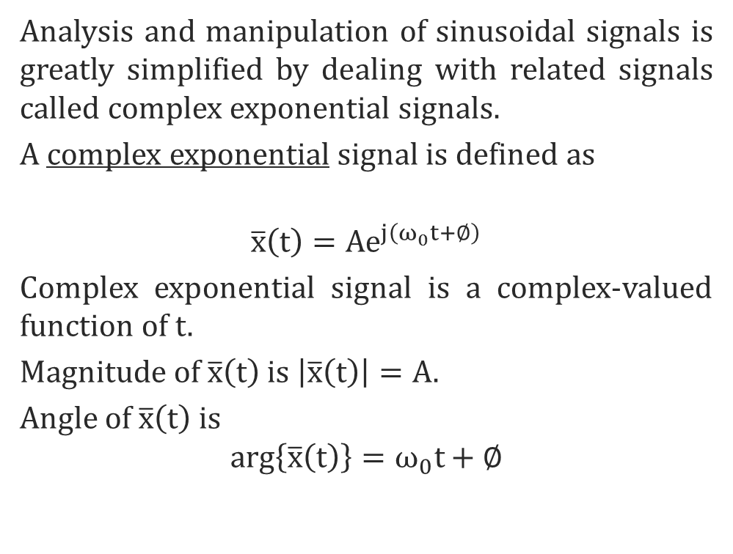
Complex Exponential Signals
Analysis and manipulation of sinusoidal signals is greatly simplified by dealing with related signals called complex exponential signals.
A complex exponential signal is defined as
$$\overline{x}\left(t\right)=Ae^{j\left(ω_{0}t+∅\right)}$$
Complex exponential signal is a complex-valued function of t.
Magnitude of $\overline{x}\left(t\right)$ is $\left|\overline{x}\left(t\right)\right|=A.$
Angle of $\overline{x}\left(t\right)$ is
$$arg\left\{\overline{x}\left(t\right)\right\}=ω_{0}t+∅$$
Copyright 2012 | Instructor: Dr. Gülden Köktürk | EED1004-INTRODUCTION TO SIGNAL PROCESSING

Slide 13
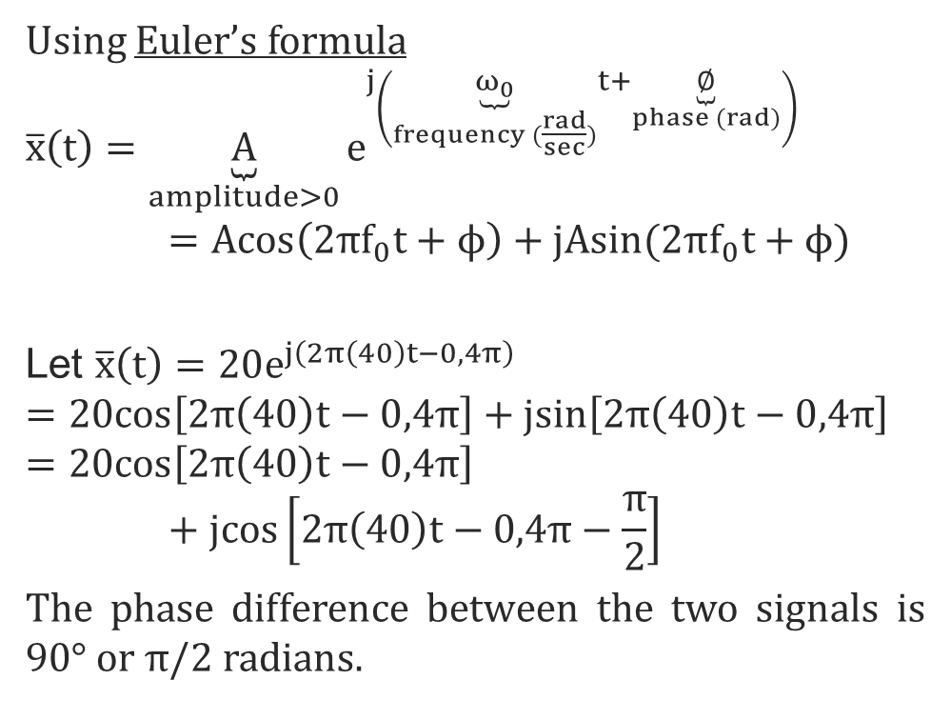
Using Euler’s formula
$$\overline{x}\left(t\right)=\underset{amplitude>0}{\underbrace{A}}e^{j\left(\underset{frequency (\frac{rad}{sec})}{\underbrace{ω_{0}}}t+\underset{phase (rad)}{\underbrace{∅}}\right)}=Acos\left(2πf_{0}t+ϕ\right)+jAsin(2πf_{0}t+ϕ)$$
Let $\overline{x}\left(t\right)=20e^{j\left(2π\left(40\right)t−0,4π\right)}$
$$=20cos\left[2π\left(40\right)t−0,4π\right]+jsin\left[2π\left(40\right)t−0,4π\right]$$
$$=20cos\left[2π\left(40\right)t−0,4π\right]+jcos\left[2π\left(40\right)t−0,4π−\frac{π}{2}\right]$$
The phase difference between the two signals is 90° or π/2 radians.
Copyright 2012 | Instructor: Dr. Gülden Köktürk | EED1004-INTRODUCTION TO SIGNAL PROCESSING

Slide 14
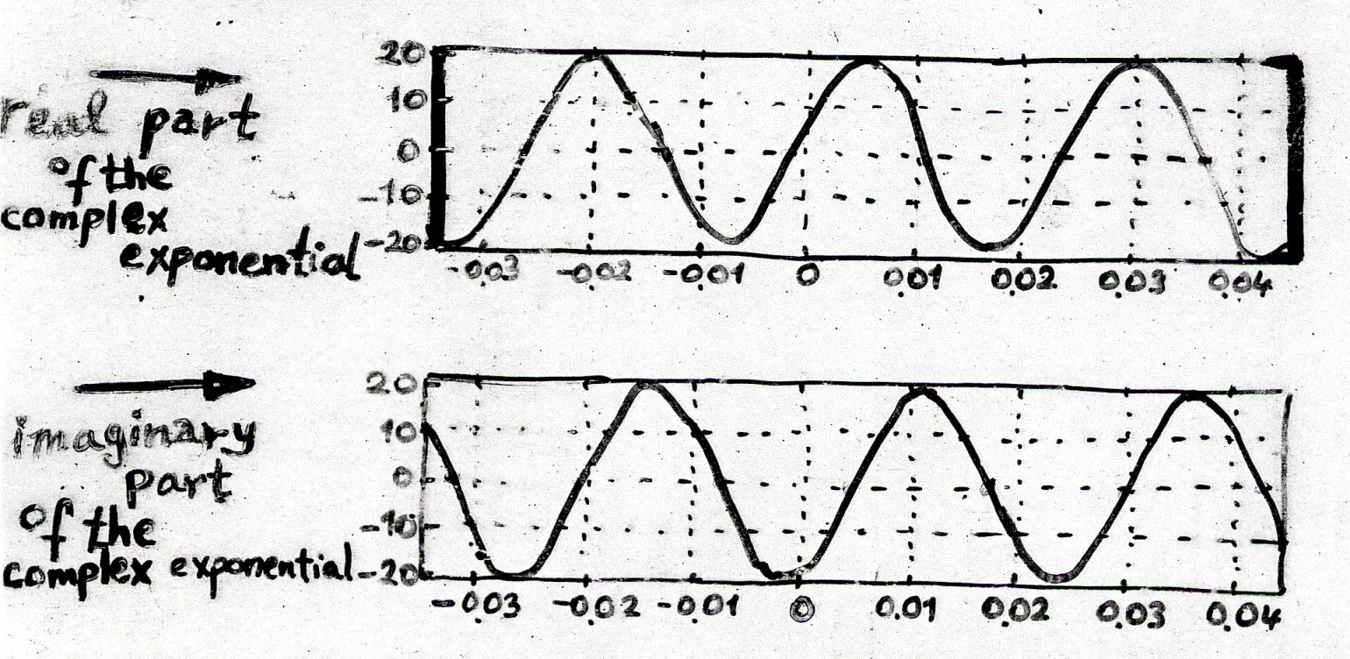

The main reason we are interested in complex exponential is that it is analternative representation for the real cosine signal. Because, we can always write,
x$\left(t\right)=Re\left\{e^{j\left(ω_{0}t+∅\right)}\right\}=Acos\left(ω_{0}+ϕ\right)$
Copyright 2012 | Instructor: Dr. Gülden Köktürk | EED1004-INTRODUCTION TO SIGNAL PROCESSING

