Slide 1
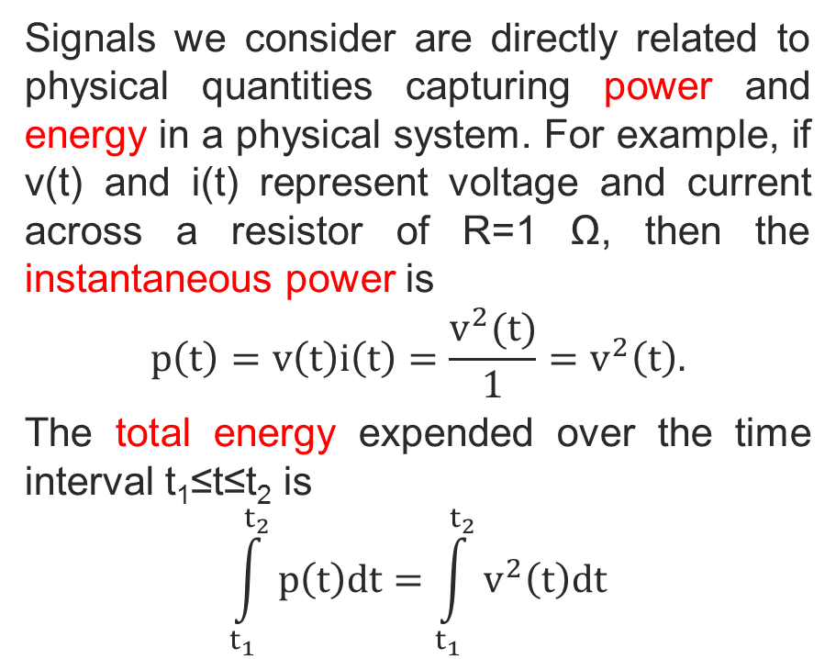
ENERGY AND POWER SIGNALS
Signals we consider are directly related to physical quantities capturing power and energy in a physical system. For example, if v(t) and i(t) represent voltage and current across a resistor of R=1 Ω, then the instantaneous power is
$$p\left(t\right)=v\left(t\right)i\left(t\right)=\frac{v^{2}(t)}{1}=v^{2}\left(t\right).$$
The total energy expended over the time interval t₁≤t≤t₂ is
$$\int_{t_{1}}^{t_{2}}{p\left(t\right)dt}=\int_{t_{1}}^{t_{2}}{v^{2}\left(t\right)dt}$$
Copyright 2012 | Instructor: Dr. Gülden Köktürk | EED1004-INTRODUCTION TO SIGNAL PROCESSING

Slide 2
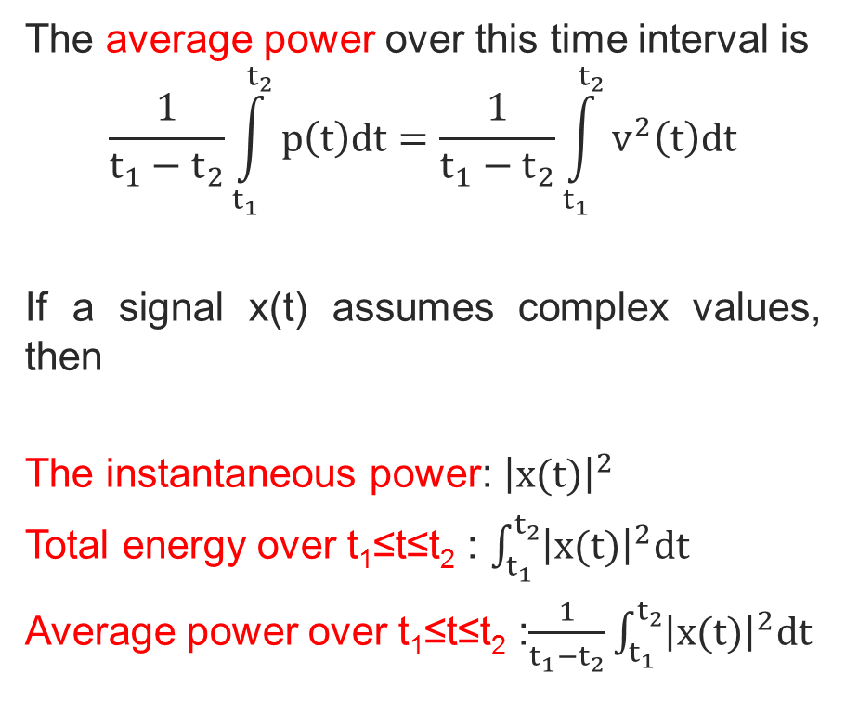
The average power over this time interval is
$$\frac{1}{t_{1}−t_{2}}\int_{t_{1}}^{t_{2}}{p\left(t\right)dt}=\frac{1}{t_{1}−t_{2}}\int_{t_{1}}^{t_{2}}{v^{2}\left(t\right)dt}$$
If a signal x(t) assumes complex values, then
The instantaneous power: ${\left|x(t)\right|}^{2}$
Total energy over t₁≤t≤t₂ : $\int_{t_{1}}^{t_{2}}{{\left|x(t)\right|}^{2}dt}$
Average power over t₁≤t≤t₂ :$\frac{1}{t_{1}−t_{2}}\int_{t_{1}}^{t_{2}}{{\left|x(t)\right|}^{2}dt}$
Copyright 2012 | Instructor: Dr. Gülden Köktürk | EED1004-INTRODUCTION TO SIGNAL PROCESSING

Slide 3

If the signal x[n] is discrete-time:
The instantaneous power: ${\left|x[n]\right|}^{2}$
Total energy over t₁≤t≤t₂ : $\sum_{n=n_{1}}^{n_{2}}{{\left|x[n]\right|}^{2}}$
Average power over t₁≤t≤t₂ :
$$\frac{1}{n_{2}−n_{1}+1}\sum_{n=n_{1}}^{n_{2}}{{\left|x[n]\right|}^{2}}$$
In many systems, we are interested in examining POWER and ENERGY in signals over an infinite time interval $\underset{continuous−time}{\underbrace{−∞<t<+∞}}$ and $\underset{discrete−time}{\underbrace{−∞<n<+∞}}$
Copyright 2012 | Instructor: Dr. Gülden Köktürk | EED1004-INTRODUCTION TO SIGNAL PROCESSING

Slide 4
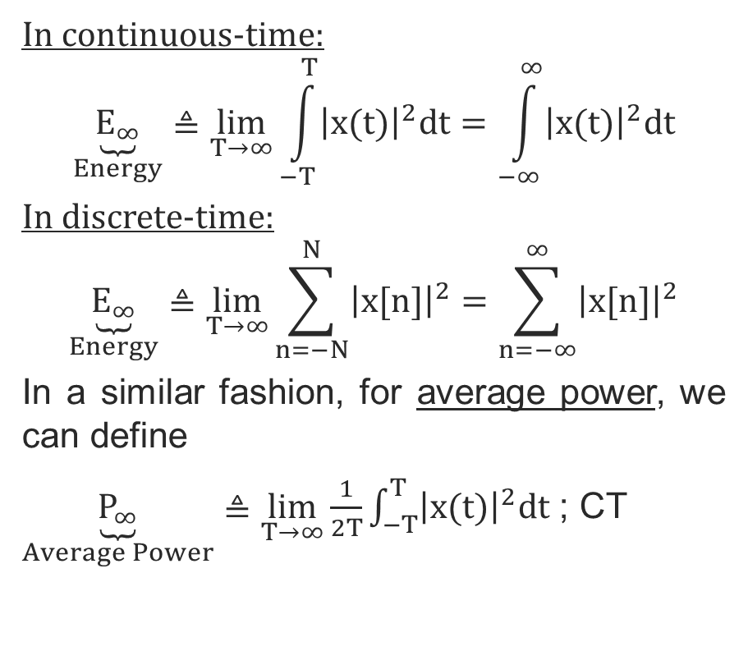
In continuous-time:
$$\underset{Energy}{\underbrace{E_{∞}}}≜\lim_{T→∞}{\int_{−T}^{T}{{\left|x(t)\right|}^{2}dt}=\int_{−∞}^{∞}{{\left|x(t)\right|}^{2}dt}}$$
In discrete-time:
$$\underset{Energy}{\underbrace{E_{∞}}}≜\lim_{T→∞}{\sum_{n=−N}^{N}{{\left|x[n]\right|}^{2}=\sum_{n=−∞}^{∞}{{\left|x[n]\right|}^{2}}}}$$
In a similar fashion, for average power, we can define
$\underset{Average Power}{\underbrace{P_{∞}}}≜\lim_{T→∞}{\frac{1}{2T}\int_{−T}^{T}{{\left|x(t)\right|}^{2}dt}}$ ; CT
Copyright 2012 | Instructor: Dr. Gülden Köktürk | EED1004-INTRODUCTION TO SIGNAL PROCESSING

Slide 5
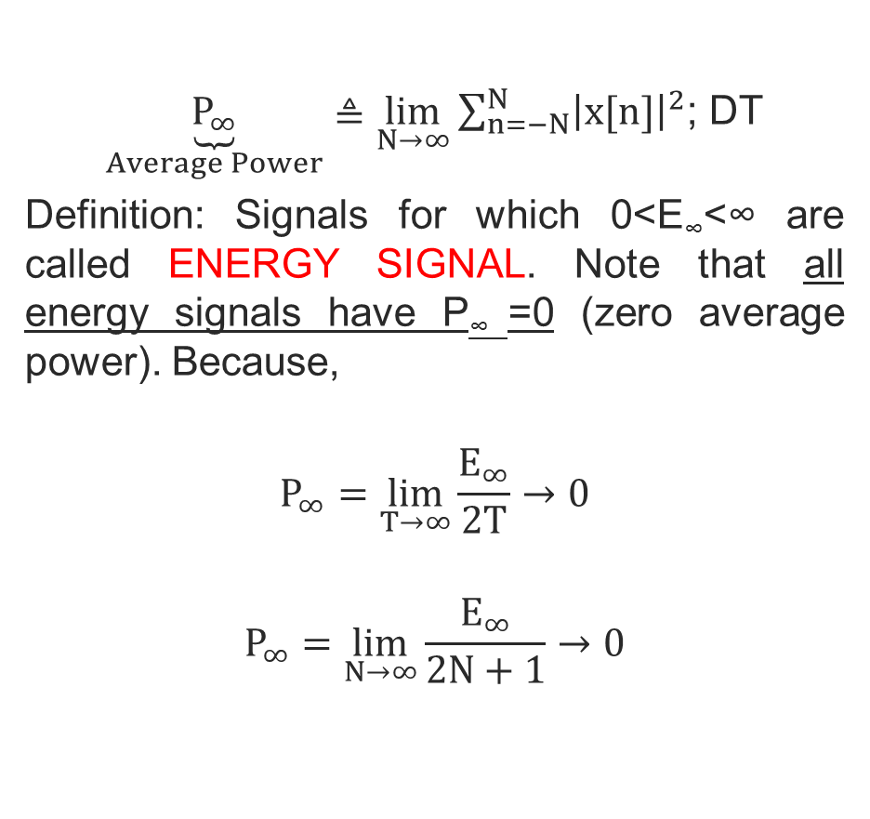
$\underset{Average Power}{\underbrace{P_{∞}}}≜\lim_{N→∞}{\sum_{n=−N}^{N}{{\left|x[n]\right|}^{2}}}$; DT
Definition: Signals for which 0<E∞<∞ are called ENERGY SIGNAL. Note that all energy signals have P∞ =0 (zero average power). Because,
$$P_{∞}=\lim_{T→∞}{\frac{E_{∞}}{2T}}→0$$
$$P_{∞}=\lim_{N→∞}{\frac{E_{∞}}{2N+1}}→0$$
Copyright 2012 | Instructor: Dr. Gülden Köktürk | EED1004-INTRODUCTION TO SIGNAL PROCESSING

Slide 6
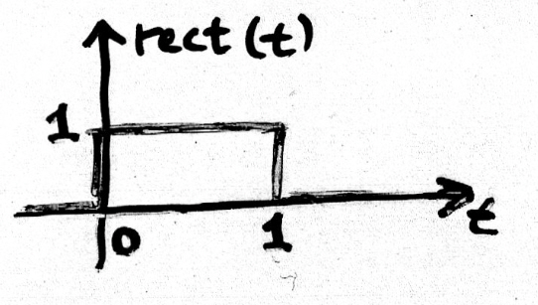
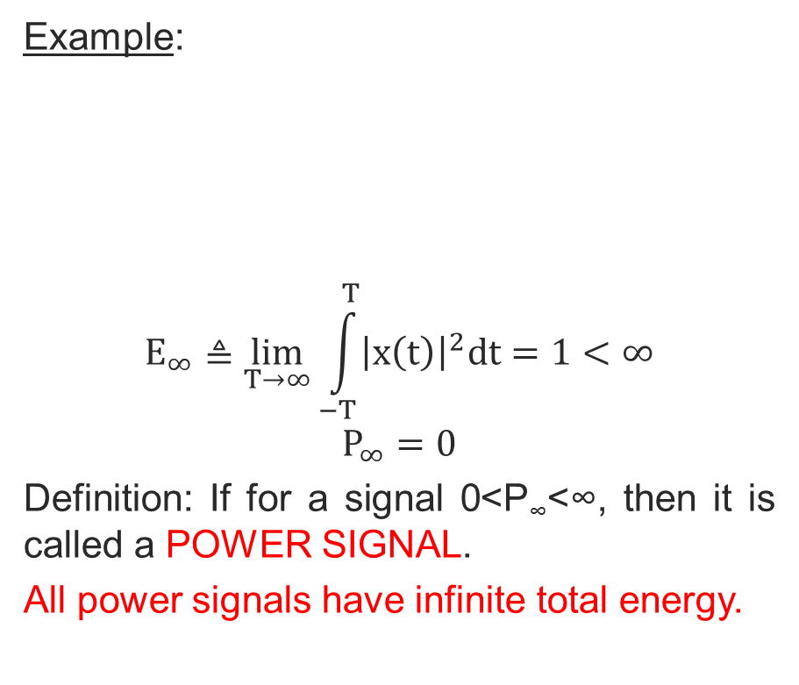
Example:
$$E_{∞}≜\lim_{T→∞}{\int_{−T}^{T}{{\left|x\left(t\right)\right|}^{2}dt}=1<∞}$$
$$P_{∞}=0$$
Definition: If for a signal 0<P∞<∞, then it is called a POWER SIGNAL.
All power signals have infinite total energy.
Copyright 2012 | Instructor: Dr. Gülden Köktürk | EED1004-INTRODUCTION TO SIGNAL PROCESSING

Slide 7
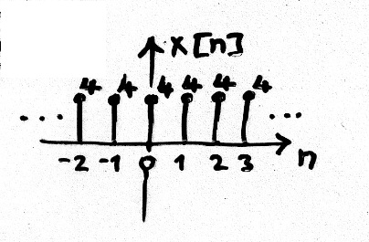

Because,
$$E_{∞}=\lim_{T→∞}{{2T.P}_{∞}}→∞$$
or
$$E_{∞}=\lim_{N→∞}{{2(N+1).P}_{∞}}→∞$$
Example:
Copyright 2012 | Instructor: Dr. Gülden Köktürk | EED1004-INTRODUCTION TO SIGNAL PROCESSING

Slide 8
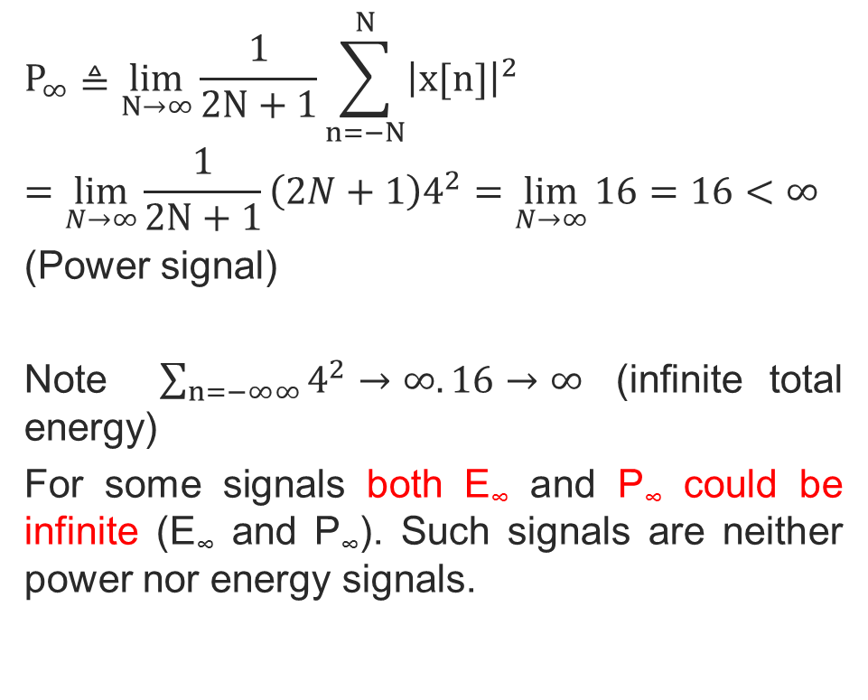
$$P_{∞}≜\lim_{N→∞}{\frac{1}{2N+1}\sum_{n=−N}^{N}{{\left|x[n]\right|}^{2}}}$$
$$=\lim_{N→∞}{\frac{1}{2N+1}\left(2N+1\right)4^{2}=\lim_{N→∞}{16}=16<∞}$$
(Power signal)
Note $\sum_{n=−∞∞}{4^{2}}→∞.16→∞$ (infinite total energy)
For some signals both E∞ and P∞ could be infinite (E∞ and P∞). Such signals are neither power nor energy signals.
Copyright 2012 | Instructor: Dr. Gülden Köktürk | EED1004-INTRODUCTION TO SIGNAL PROCESSING

Slide 9
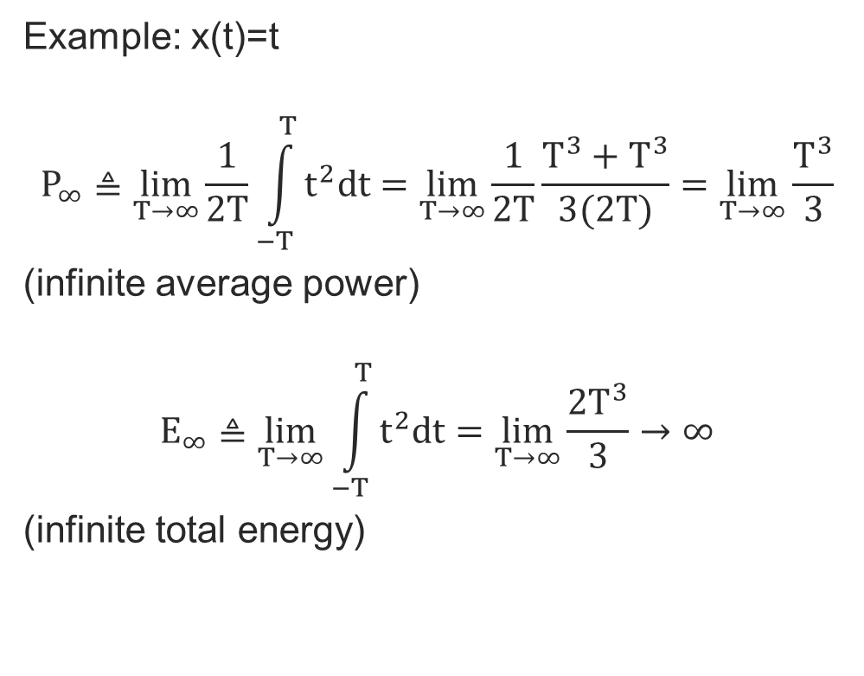
Example: x(t)=t
$$P_{∞}≜\lim_{T→∞}{\frac{1}{2T}\int_{−T}^{T}{t^{2}dt=\lim_{T→∞}{\frac{1}{2T}\frac{T^{3}+T^{3}}{3(2T)}=\lim_{T→∞}{\frac{T^{3}}{3}}}}}$$
(infinite average power)
$$E_{∞}≜\lim_{T→∞}{\int_{−T}^{T}{t^{2}dt=\lim_{T→∞}{\frac{2T^{3}}{3}→∞}}}$$
(infinite total energy)
Copyright 2012 | Instructor: Dr. Gülden Köktürk | EED1004-INTRODUCTION TO SIGNAL PROCESSING

Slide 10
The total energy of a periodic signal x(t) (or x[n]) over a single period (T or N) is finite (<∞) if x(t) (or x[n]) takes on finite values over the period. However, the total energy of the periodic signal for -∞<t<∞ (or -∞<n<∞) is infinite.
On the other hand, the average power of the periodic signal is finite and it is equal to the average power over a single period.
Copyright 2012 | Instructor: Dr. Gülden Köktürk | EED1004-INTRODUCTION TO SIGNAL PROCESSING

Slide 11
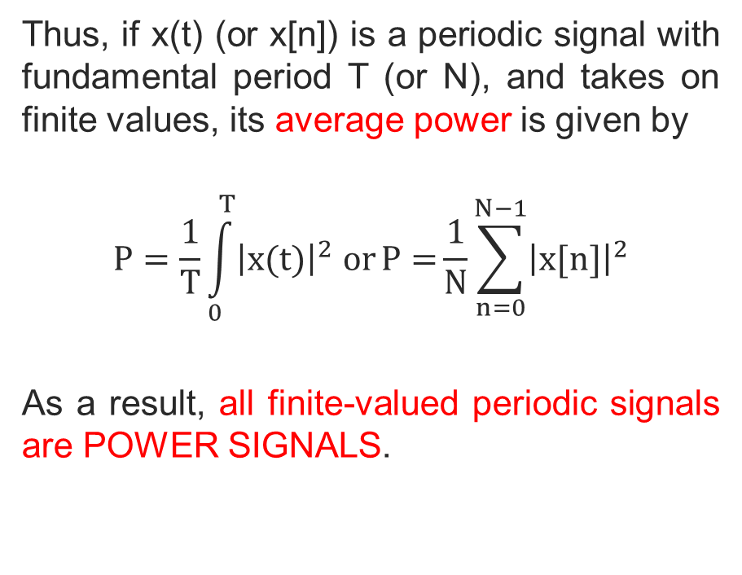
Thus, if x(t) (or x[n]) is a periodic signal with fundamental period T (or N), and takes on finite values, its average power is given by
$$P=\frac{1}{T}\int_{0}^{T}{{\left|x(t)\right|}^{2} orP={\frac{1}{N}\sum_{n=0}^{N−1}{{\left|x[n]\right|}^{2}}}}$$
As a result, all finite-valued periodic signals are POWER SIGNALS.
Copyright 2012 | Instructor: Dr. Gülden Köktürk | EED1004-INTRODUCTION TO SIGNAL PROCESSING

Slide 12
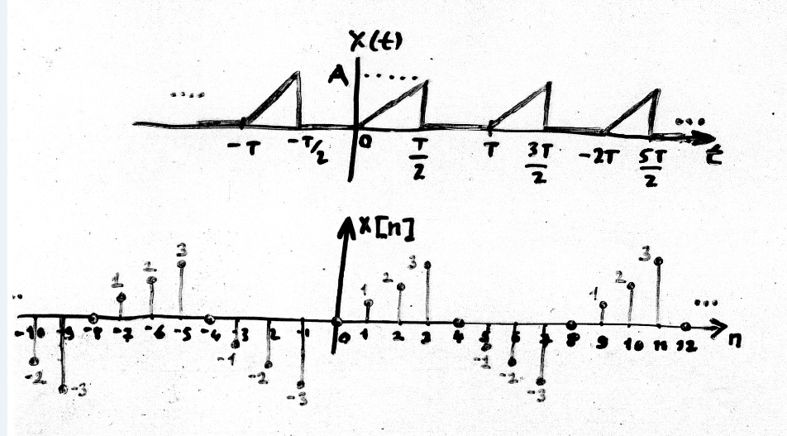
Exercise:
Find the average power of the following periodic signals.
Copyright 2012 | Instructor: Dr. Gülden Köktürk | EED1004-INTRODUCTION TO SIGNAL PROCESSING

Slide 13
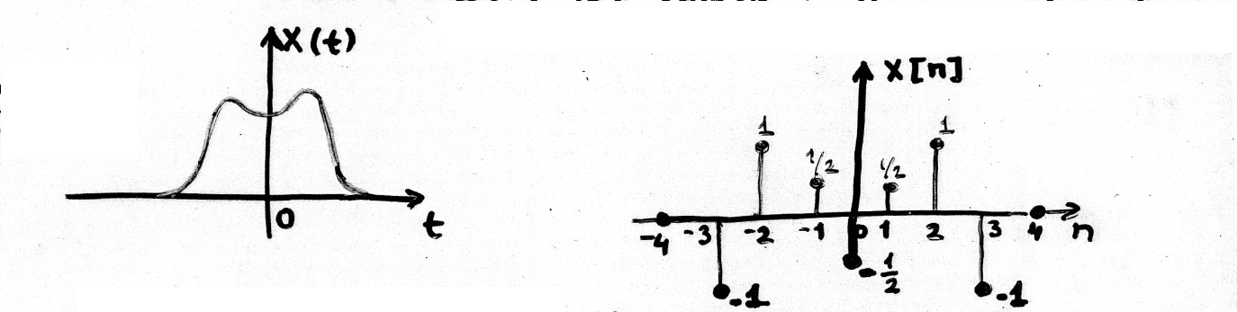
Even and Odd Signals
A real-valued signal is said to be even symmetric x(t)=x(-t) (continuous-time) x[n]=x[-n] (discrete-time). On the other hand, the signal is odd symmetric if x(t)=-x(-t). An even symmetric signal is identical to its axis-reversed counterpart (symmetry with respect to vertical axis) as shown in the examples below.
Even symmetric signals
Copyright 2012 | Instructor: Dr. Gülden Köktürk | EED1004-INTRODUCTION TO SIGNAL PROCESSING

Slide 14
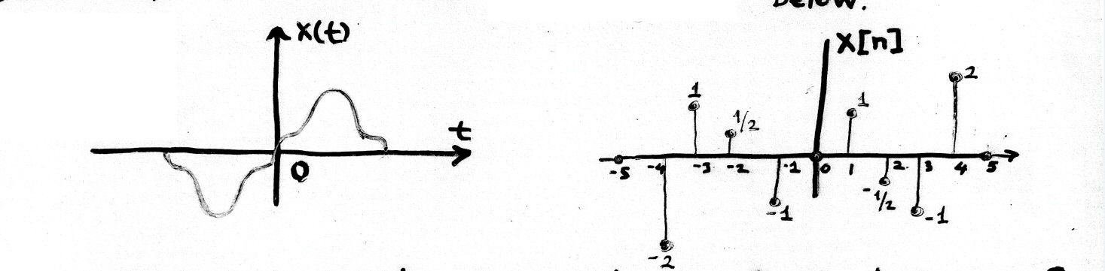
An odd symmetric signal is identical to the negative of its axis-reversed counterpart (symmetry with respect to origin) as shown in the examples below.
Copyright 2012 | Instructor: Dr. Gülden Köktürk | EED1004-INTRODUCTION TO SIGNAL PROCESSING

Slide 15
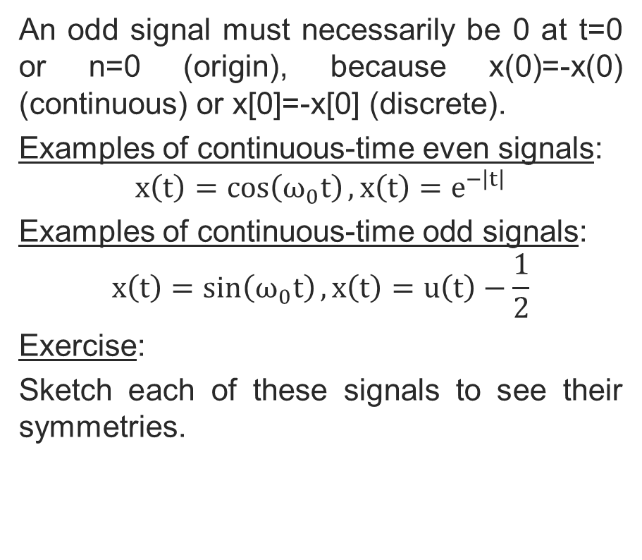
An odd signal must necessarily be 0 at t=0 or n=0 (origin), because x(0)=-x(0) (continuous) or x[0]=-x[0] (discrete).
Examples of continuous-time even signals:
$$x\left(t\right)=\cos\left(ω_{0}t\right), x\left(t\right)=e^{−\left|t\right|}$$
Examples of continuous-time odd signals:
$$x\left(t\right)=\sin\left(ω_{0}t\right), x\left(t\right)=u\left(t\right)−\frac{1}{2}$$
Exercise:
Sketch each of these signals to see their symmetries.
Copyright 2012 | Instructor: Dr. Gülden Köktürk | EED1004-INTRODUCTION TO SIGNAL PROCESSING

Slide 16
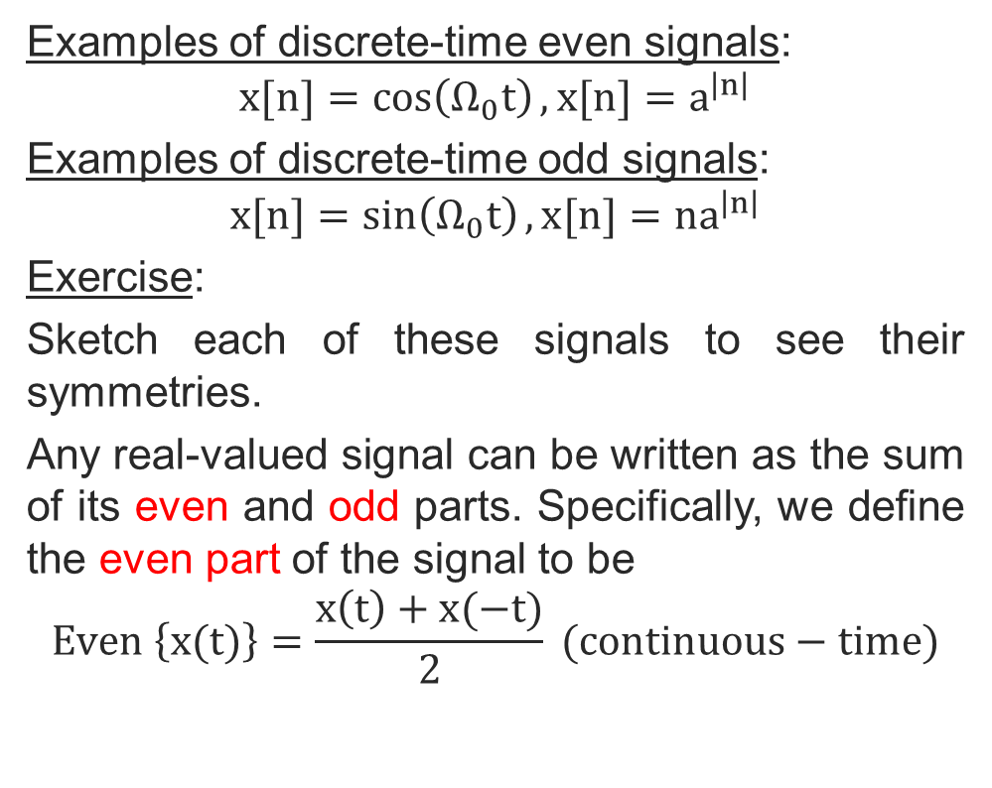
Examples of discrete-time even signals:
$$x[n]=\cos\left(Ω_{0}t\right), x[n]=a^{\left|n\right|}$$
Examples of discrete-time odd signals:
$$x[n]=\sin\left(Ω_{0}t\right), x[n]={na}^{\left|n\right|}$$
Exercise:
Sketch each of these signals to see their symmetries.
Any real-valued signal can be written as the sum of its even and odd parts. Specifically, we define the even part of the signal to be
$$Even \left\{x(t)\right\}=\frac{x\left(t\right)+x(−t)}{2} (continuous−time)$$
Copyright 2012 | Instructor: Dr. Gülden Köktürk | EED1004-INTRODUCTION TO SIGNAL PROCESSING

Slide 17
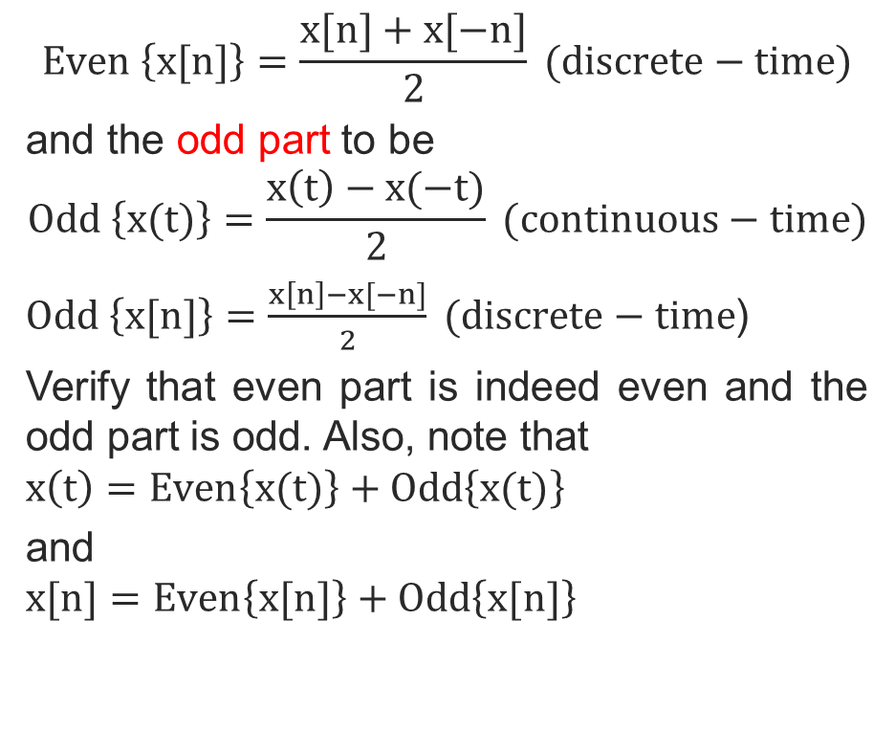
$$Even \left\{x[n]\right\}=\frac{x[n]+x[−n]}{2} (discrete−time)$$
and the odd part to be
$$Odd \left\{x(t)\right\}=\frac{x\left(t\right)−x(−t)}{2} (continuous−time)$$
$Odd \left\{x[n]\right\}=\frac{x\left[n\right]−x[−n]}{2} (discrete−time$)
Verify that even part is indeed even and the odd part is odd. Also, note that
$$x\left(t\right)=Even\left\{x(t)\right\}+Odd\left\{x(t)\right\}$$
and
$$x[n]=Even\left\{x[n]\right\}+Odd\left\{x[n]\right\}$$
Copyright 2012 | Instructor: Dr. Gülden Köktürk | EED1004-INTRODUCTION TO SIGNAL PROCESSING

Slide 18
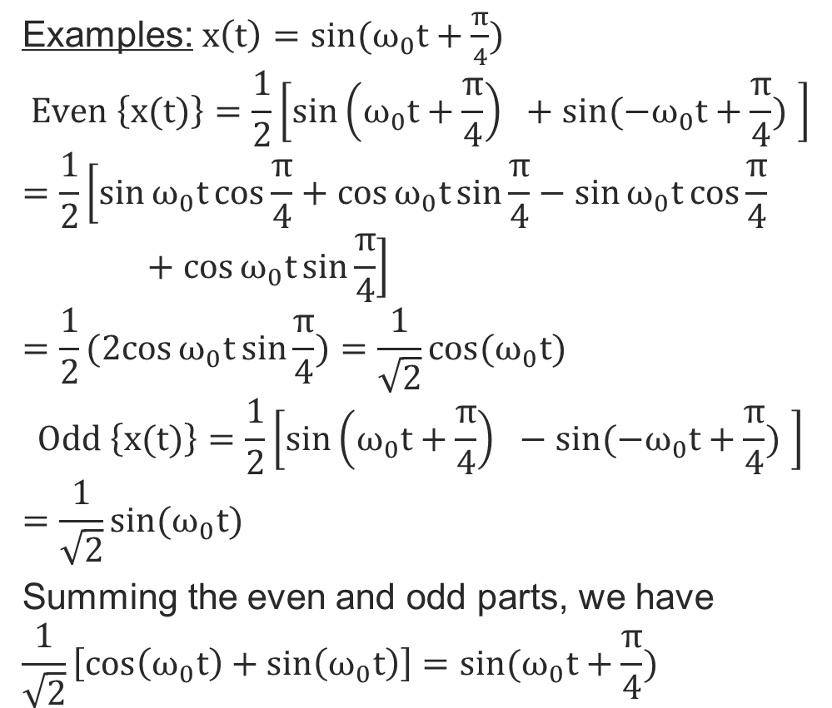
Examples: $x\left(t\right)=sin⁡(ω_{0}t+\frac{π}{4})$
$$Even \left\{x(t)\right\}=\frac{1}{2}\left[\sin\left(ω_{0}t+\frac{π}{4}\right) +sin⁡({−ω}_{0}t+\frac{π}{4}) \right]$$
$$=\frac{1}{2}\left[\sin{ω_{0}t}cos\frac{π}{4}+\cos{ω_{0}t}sin\frac{π}{4}−\sin{ω_{0}t}cos\frac{π}{4}+\cos{ω_{0}t}sin\frac{π}{4}\right]$$
$$=\frac{1}{2}(2cos{ω_{0}t}sin\frac{π}{4})=\frac{1}{\sqrt{2}}cos⁡(ω_{0}t)$$
$$Odd \left\{x(t)\right\}=\frac{1}{2}\left[\sin\left(ω_{0}t+\frac{π}{4}\right) −sin⁡({−ω}_{0}t+\frac{π}{4}) \right]$$
$$=\frac{1}{\sqrt{2}}sin⁡(ω_{0}t)$$
Summing the even and odd parts, we have
$$\frac{1}{\sqrt{2}}\left[cos\left(ω_{0}t\right)+\sin\left(ω_{0}t\right)\right]=sin⁡(ω_{0}t+\frac{π}{4})$$
Copyright 2012 | Instructor: Dr. Gülden Köktürk | EED1004-INTRODUCTION TO SIGNAL PROCESSING

Slide 19
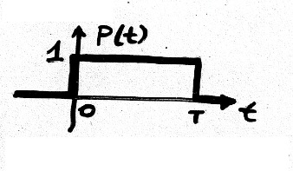
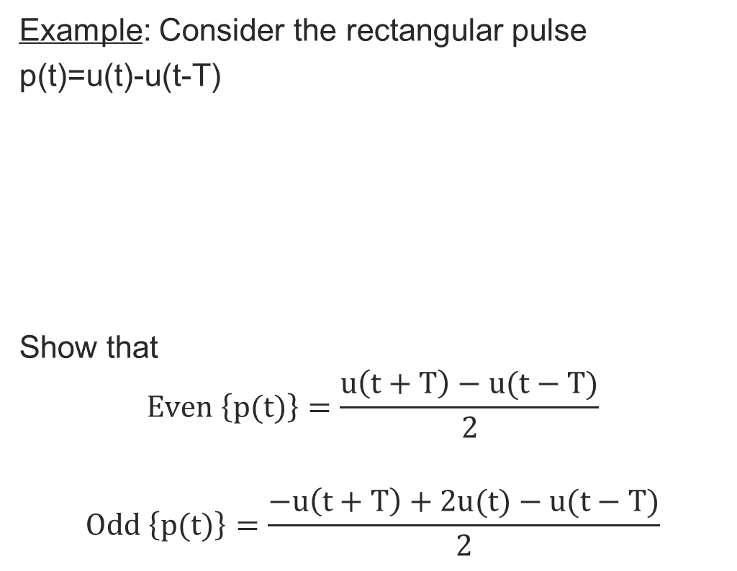
Example: Consider the rectangular pulse
p(t)=u(t)-u(t-T)
Show that
$$Even \left\{p(t)\right\}=\frac{u\left(t+T\right)−u(t−T)}{2}$$
$$Odd \left\{p(t)\right\}=\frac{−u\left(t+T\right)+2u(t)−u(t−T)}{2}$$
Copyright 2012 | Instructor: Dr. Gülden Köktürk | EED1004-INTRODUCTION TO SIGNAL PROCESSING

Slide 20
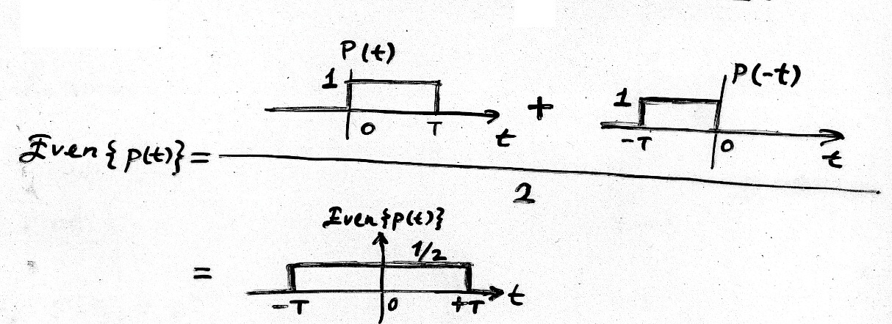
Solution:
Copyright 2012 | Instructor: Dr. Gülden Köktürk | EED1004-INTRODUCTION TO SIGNAL PROCESSING

Slide 21
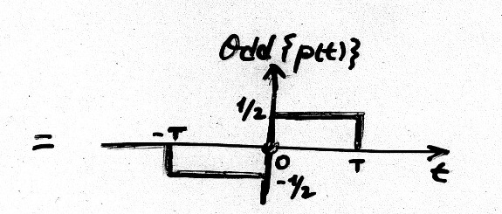

$$Odd \left\{p(t)\right\}=\frac{p\left(t\right)−p(−t)}{2}$$
Copyright 2012 | Instructor: Dr. Gülden Köktürk | EED1004-INTRODUCTION TO SIGNAL PROCESSING

Slide 22
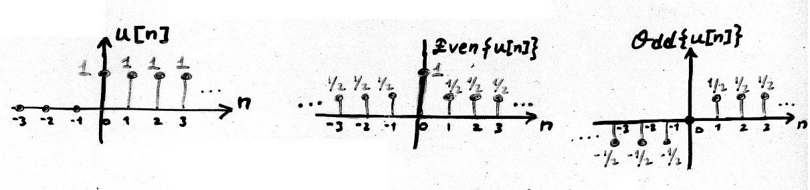

Example:
$$Even\left\{u[n]\right\}=\frac{1}{2}(1+δ\left[n\right])$$
$$Odd\left\{u[n]\right\}=\frac{1}{2}(u\left[n−1\right]−u\left[−n−1\right])$$
Copyright 2012 | Instructor: Dr. Gülden Köktürk | EED1004-INTRODUCTION TO SIGNAL PROCESSING

