Slide 1
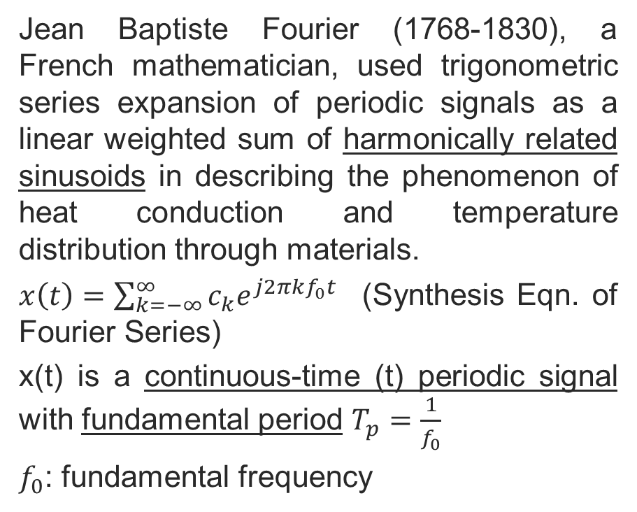
Fourier Series for Continuous-Time Periodic Signals
Jean Baptiste Fourier (1768-1830), a French mathematician, used trigonometric series expansion of periodic signals as a linear weighted sum of harmonically related sinusoids in describing the phenomenon of heat conduction and temperature distribution through materials.
$x\left(t\right)=\sum_{k=−∞}^{∞}{c_{k}e^{j2πkf_{0}t}}$ (Synthesis Eqn. of Fourier Series)
x(t) is a continuous-time (t) periodic signal with fundamental period $T_{p}=\frac{1}{f_{0}}$
$f_{0}$: fundamental frequency
Copyright 2012 | Instructor: Dr. Gülden Köktürk | EED1004-INTRODUCTION TO SIGNAL PROCESSING

Slide 2
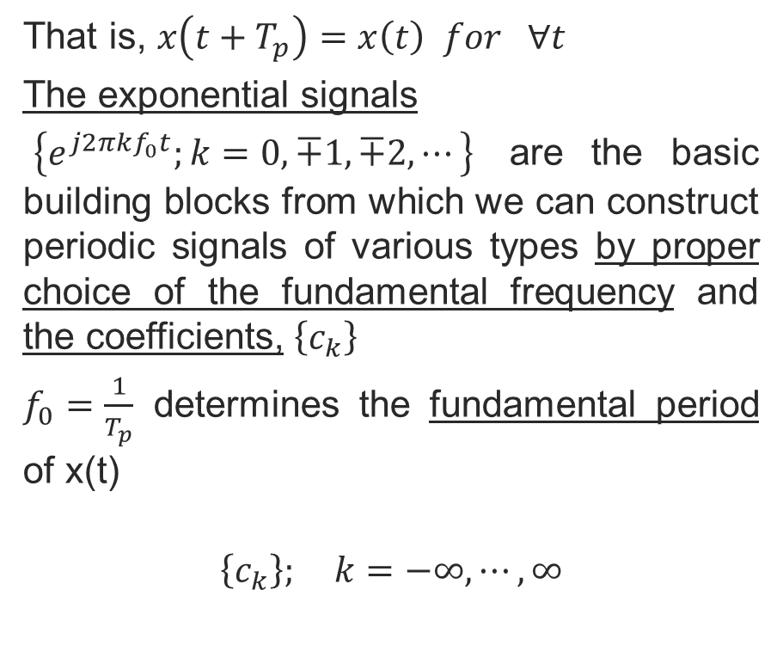
That is, $x\left(t+T_{p}\right)=x\left(t\right) for ∀t$
The exponential signals
$\left\{e^{j2πkf_{0}t};k=0, ∓1, ∓2, ⋯\right\}$ are the basic building blocks from which we can construct periodic signals of various types by proper choice of the fundamental frequency and the coefficients, $\left\{c_{k}\right\}$
$f_{0}=\frac{1}{T_{p}}$ determines the fundamental period of x(t)
$$\left\{c_{k}\right\}; k=−∞,⋯, ∞$$
Copyright 2012 | Instructor: Dr. Gülden Köktürk | EED1004-INTRODUCTION TO SIGNAL PROCESSING

Slide 3

Example: Let us consider a period signal
$x\left(t\right)=\sum_{k=−3}^{3}{{c_{k}e}^{j2πkt}}$ with fundamental frequency $f_{0}=1$ and let’s assume coefficients $c_{0}=1, c_{1}=c_{−1}=\frac{1}{4}, c_{2}=c_{−2}=\frac{1}{2}, c_{3}=c_{−3}=\frac{1}{3}$
x(t) can be rewritten as
$$x\left(t\right)=\sum_{k=−3}^{3}{{c_{k}e}^{j2πkt}}=1+\frac{1}{4}(e^{j2πt}+e^{−j2πt})+\frac{1}{2}(e^{j4πt}+e^{−j4πt})+\frac{1}{3}(e^{j6πt}+e^{−j6πt})$$
Copyright 2012 | Instructor: Dr. Gülden Köktürk | EED1004-INTRODUCTION TO SIGNAL PROCESSING

Slide 4
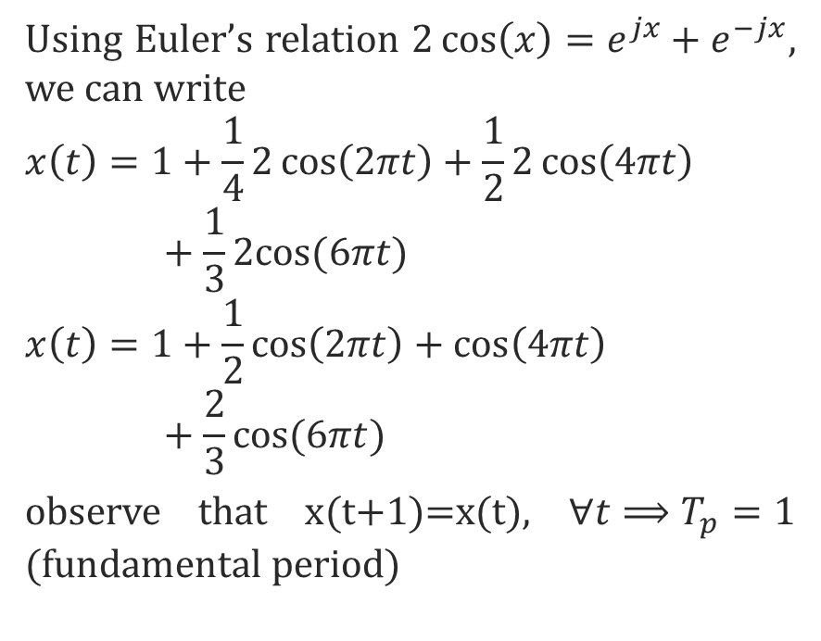
Using Euler’s relation $2\cos\left(x\right)=e^{jx}+e^{−jx}$, we can write
$$x\left(t\right)=1+\frac{1}{4}2\cos\left(2πt\right)+\frac{1}{2}2\cos\left(4πt\right)+\frac{1}{3}2cos⁡(6πt)$$
$$x\left(t\right)=1+\frac{1}{2}\cos\left(2πt\right)+\cos\left(4πt\right)+\frac{2}{3}cos⁡(6πt)$$
observe that x(t+1)=x(t), $∀t⟹T_{p}=1$ (fundamental period)
Copyright 2012 | Instructor: Dr. Gülden Köktürk | EED1004-INTRODUCTION TO SIGNAL PROCESSING

Slide 5

$$\cos\left[2π\left(t+1\right)\right]=\cos\left(2πt\right), ∀t$$
$$\cos\left[4π\left(t+1/2\right)\right]=\cos\left(4πt\right), ∀t$$
$$\cos\left[6π\left(t+1/3\right)\right]=\cos\left(6πt\right), ∀t$$
Graphical illustration for the construction of x(t) as a linear combination of harmonically-related sinusoids
Copyright 2012 | Instructor: Dr. Gülden Köktürk | EED1004-INTRODUCTION TO SIGNAL PROCESSING

Slide 6
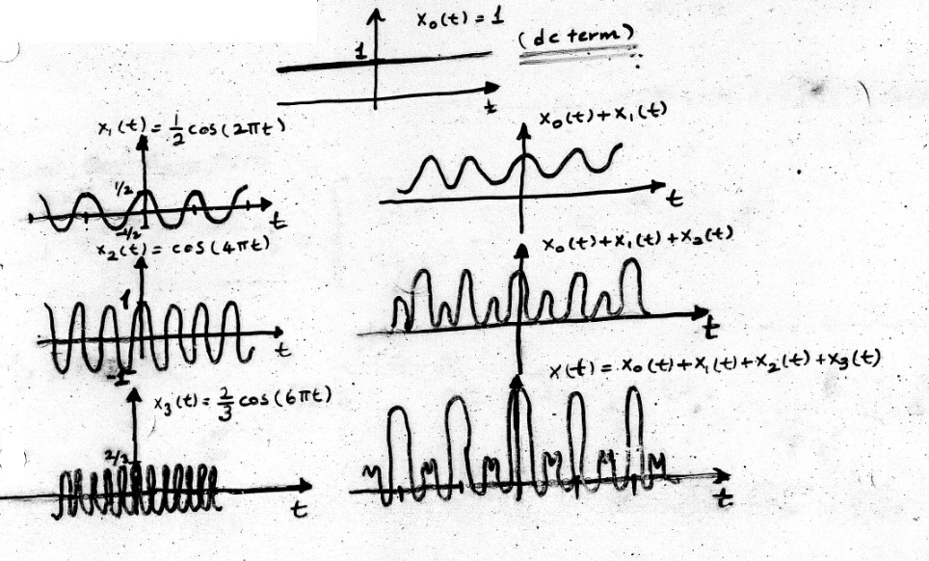
Copyright 2012 | Instructor: Dr. Gülden Köktürk | EED1004-INTRODUCTION TO SIGNAL PROCESSING

Slide 7
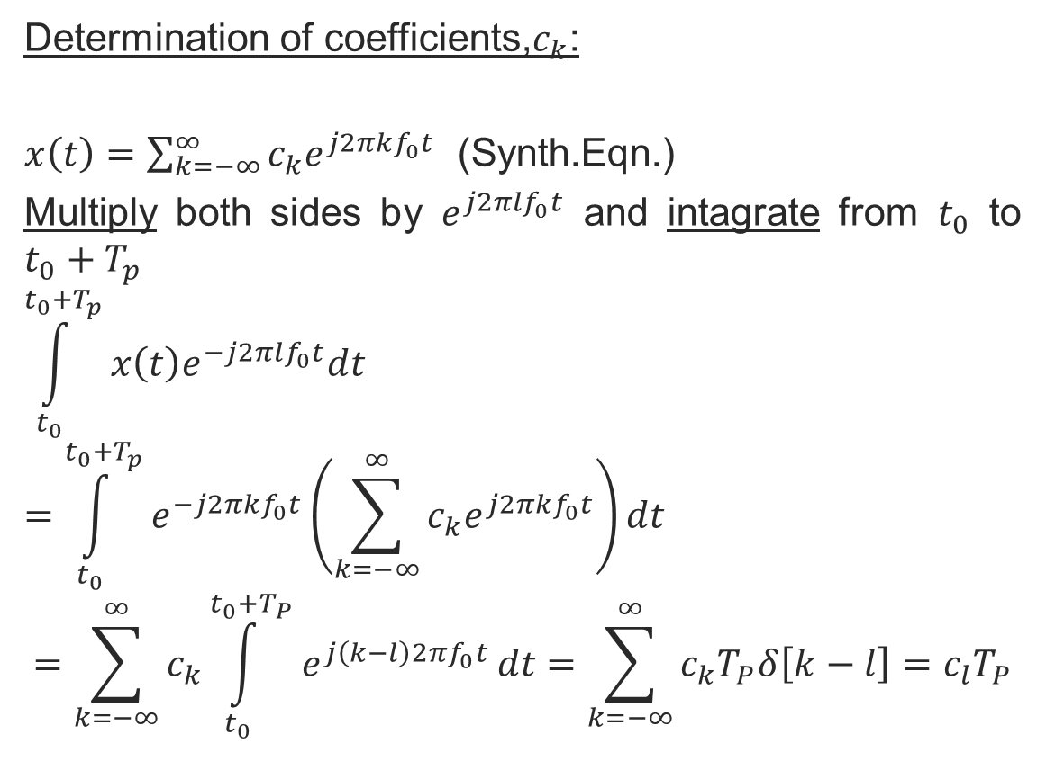
Determination of coefficients,$c_{k}$:
$x\left(t\right)=\sum_{k=−∞}^{∞}{c_{k}e^{j2πkf_{0}t}}$ (Synth.Eqn.)
Multiply both sides by $e^{j2πlf_{0}t}$ and intagrate from $t_{0}$ to $t_{0}+T_{p}$
$$\int_{t_{0}}^{t_{0}+T_{p}}{x\left(t\right)e^{−j2πlf_{0}t}dt}$$
$$=\int_{t_{0}}^{t_{0}+T_{p}}{e^{−j2πkf_{0}t}\left(\sum_{k=−∞}^{∞}{c_{k}e^{j2πkf_{0}t}}\right)dt}$$
$$=\sum_{k=−∞}^{∞}{c_{k}\int_{t_{0}}^{t_{0}+T_{P}}{e^{j\left(k−l\right)2πf_{0}t}}}dt=\sum_{k=−∞}^{∞}{c_{k}T_{P}δ\left[k−l\right]=c_{l}T_{P}}$$
Copyright 2012 | Instructor: Dr. Gülden Köktürk | EED1004-INTRODUCTION TO SIGNAL PROCESSING

Slide 8
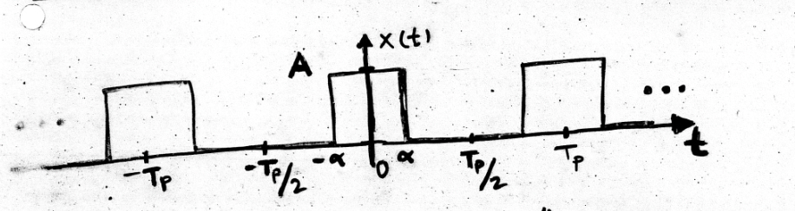

Example:
Represent the «rectangular pulse train» with Fourier series (determine the Fourier series coefficients, c_{K}). Assume T_{P}=5^{α}.
DC Term (k=0):
$$c_{0}=\frac{1}{T_{P}}\int_{{−T_{P}}/2}^{{T_{P}}/2}{x\left(t\right)dt=\frac{1}{T_{P}}\int_{−α}^{α}{Adt=\frac{2A}{5}}}$$
Copyright 2012 | Instructor: Dr. Gülden Köktürk | EED1004-INTRODUCTION TO SIGNAL PROCESSING

Slide 9
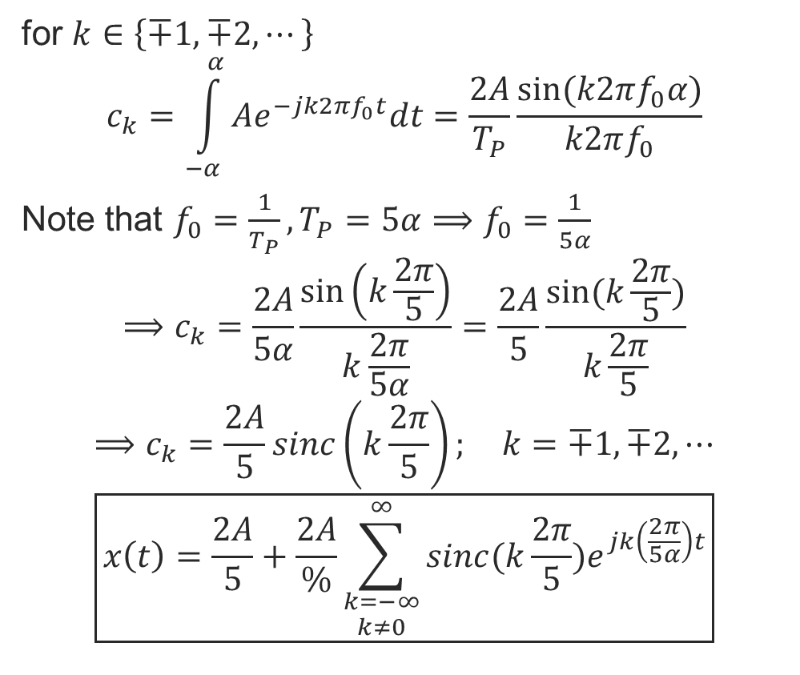
for $k∈\left\{∓1, ∓2,⋯\right\}$
$$c_{k}=\int_{−α}^{α}{Ae^{−jk2πf_{0}t}dt=\frac{2A}{T_{P}}\frac{sin⁡(k2πf_{0}α)}{k2πf_{0}}}$$
Note that $f_{0}=\frac{1}{T_{P}}, T_{P}=5α⟹f_{0}=\frac{1}{5α}$
$$⟹c_{k}=\frac{2A}{5α}\frac{\sin\left(k\frac{2π}{5}\right)}{k\frac{2π}{5α}}=\frac{2A}{5}\frac{sin⁡(k\frac{2π}{5})}{k\frac{2π}{5}}$$
$$⟹c_{k}=\frac{2A}{5}sinc\left(k\frac{2π}{5}\right); k=∓1, ∓2, ⋯$$
$$\boxed{x\left(t\right)=\frac{2A}{5}+\frac{2A}{\%}\sum_{\begin{aligned}k=−∞ \\ k≠0\end{aligned}}^{∞}{sinc(k\frac{2π}{5})e^{jk\left(\frac{2π}{5α}\right)t}}}$$
Copyright 2012 | Instructor: Dr. Gülden Köktürk | EED1004-INTRODUCTION TO SIGNAL PROCESSING

Slide 10
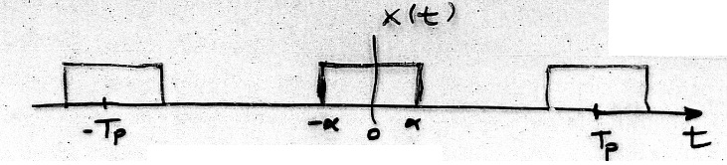

$$c_{0}=\frac{2A}{5}$$
$$c_{k}=\frac{2A}{5}sinc\left(k\frac{2π}{5}\right)$$
Copyright 2012 | Instructor: Dr. Gülden Köktürk | EED1004-INTRODUCTION TO SIGNAL PROCESSING

Slide 11
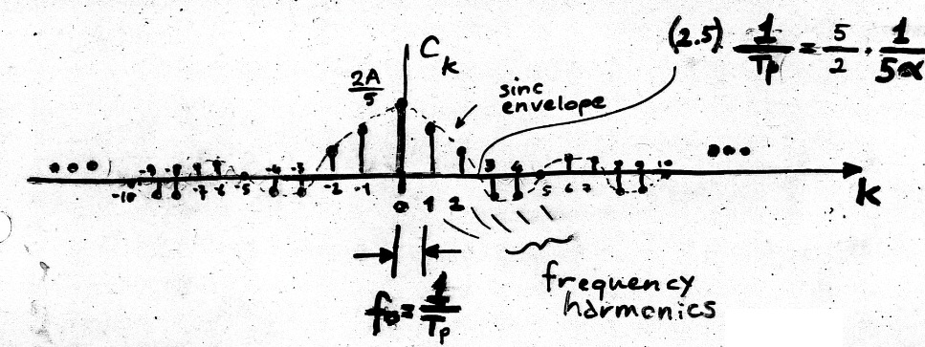

«spectrum» of the rectangular pulse train:
Frequency harmonics $→\left\{−kf_{0}, 0, kf_{0};−∞<k<∞\right\}$
Copyright 2012 | Instructor: Dr. Gülden Köktürk | EED1004-INTRODUCTION TO SIGNAL PROCESSING

Slide 12
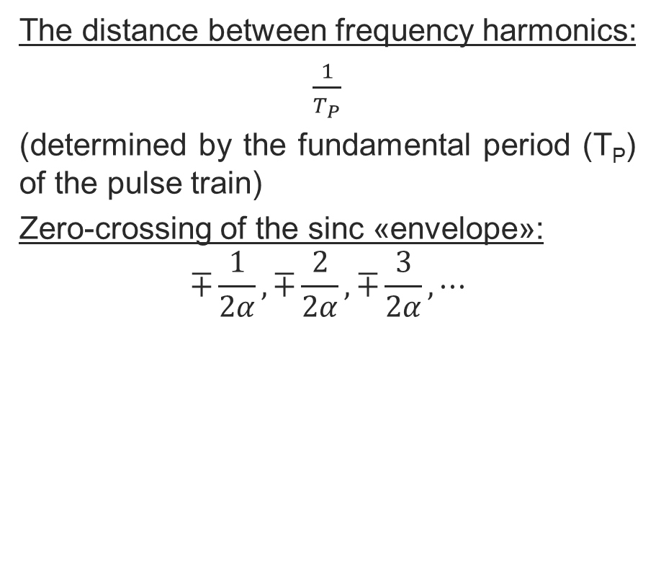
The distance between frequency harmonics:
$\frac{1}{T_{P}}$
(determined by the fundamental period (T_{P}) of the pulse train)
Zero-crossing of the sinc «envelope»:
$$∓\frac{1}{2α}, ∓\frac{2}{2α}, ∓\frac{3}{2α}, ⋯$$
Copyright 2012 | Instructor: Dr. Gülden Köktürk | EED1004-INTRODUCTION TO SIGNAL PROCESSING

Slide 13
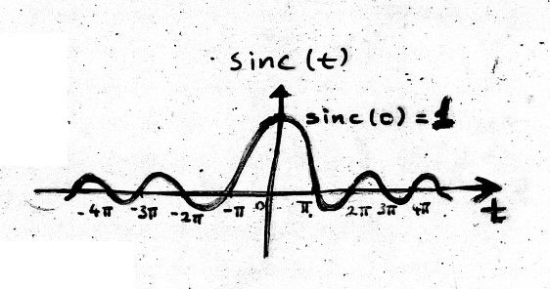

SIDE TOPIC: SINC FUNCTION
$$sinc\left(t\right)=\frac{sin⁡(t)}{t}$$
How do we calculate sinc(0)=?
Note:
$$\underset{time domain}{\underbrace{x\left(t\right):continuous and periodic}}\begin{matrix}FOURIER SERIES \\ ↔\end{matrix}\underset{frequency domain}{\underbrace{c_{k}:discrete and aperiodic}}$$
Copyright 2012 | Instructor: Dr. Gülden Köktürk | EED1004-INTRODUCTION TO SIGNAL PROCESSING

Slide 14
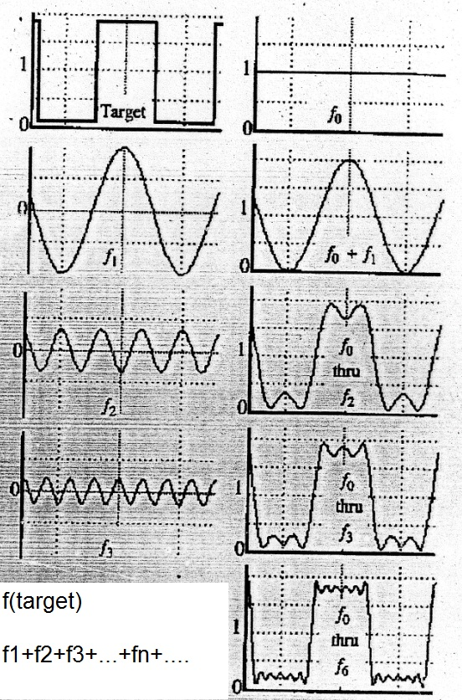
Copyright 2012 | Instructor: Dr. Gülden Köktürk | EED1004-INTRODUCTION TO SIGNAL PROCESSING

Slide 15
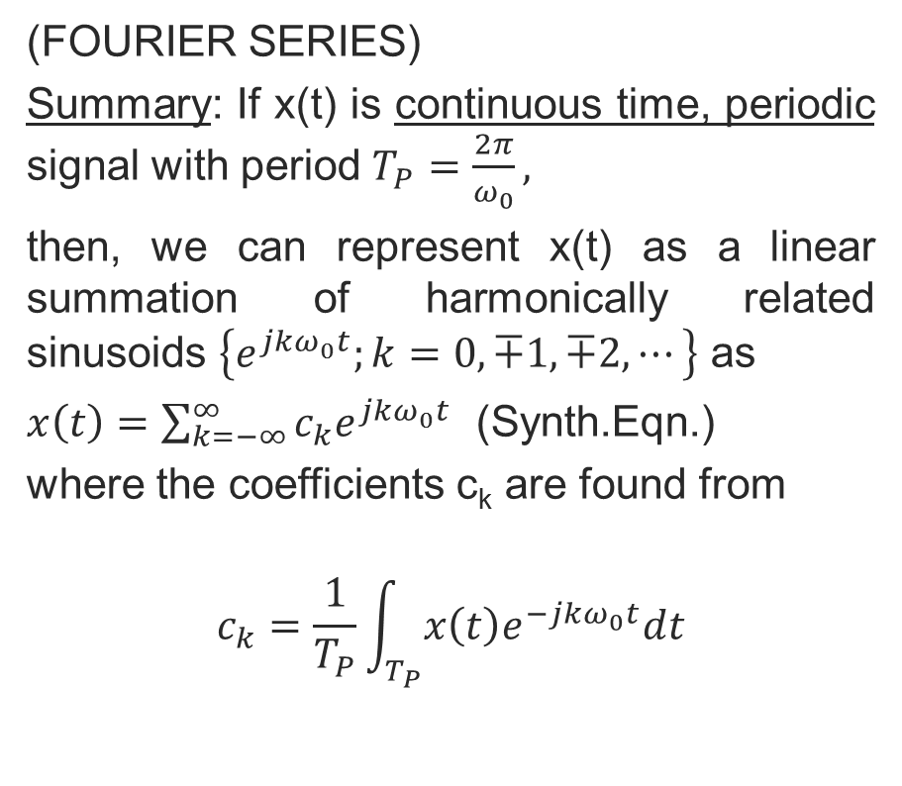
(FOURIER SERIES)
Summary: If x(t) is continuous time, periodic signal with period $T_{P}=\frac{2π}{ω_{0}},$
then, we can represent x(t) as a linear summation of harmonically related sinusoids $\left\{e^{jkω_{0}t};k=0, ∓1, ∓2, ⋯\right\}$ as
$x\left(t\right)=\sum_{k=−∞}^{∞}{c_{k}e^{jkω_{0}t}}$ (Synth.Eqn.)
where the coefficients c_{k} are found from
$$c_{k}=\frac{1}{T_{P}}\int_{T_{P}}{x\left(t\right)e^{−jkω_{0}t}dt}$$
Copyright 2012 | Instructor: Dr. Gülden Köktürk | EED1004-INTRODUCTION TO SIGNAL PROCESSING

Slide 16
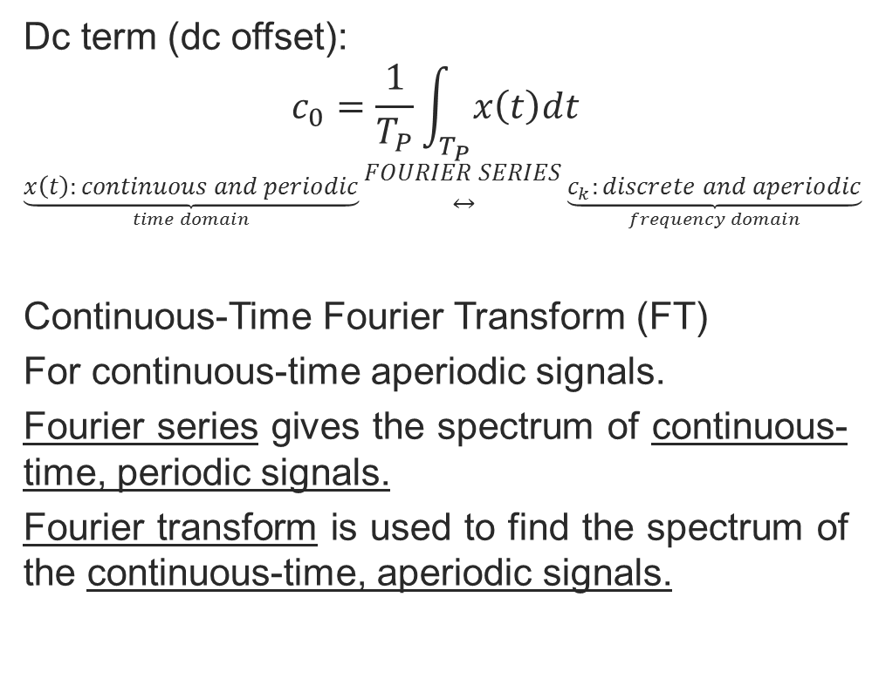
Dc term (dc offset):
$$c_{0}=\frac{1}{T_{P}}\int_{T_{P}}{x\left(t\right)dt}$$
$$\underset{time domain}{\underbrace{x\left(t\right):continuous and periodic}}\begin{matrix}FOURIER SERIES \\ ↔\end{matrix}\underset{frequency domain}{\underbrace{c_{k}:discrete and aperiodic}}$$
Continuous-Time Fourier Transform (FT)
For continuous-time aperiodic signals.
Fourier series gives the spectrum of continuous-time, periodic signals.
Fourier transform is used to find the spectrum of the continuous-time, aperiodic signals.
Copyright 2012 | Instructor: Dr. Gülden Köktürk | EED1004-INTRODUCTION TO SIGNAL PROCESSING

Slide 17
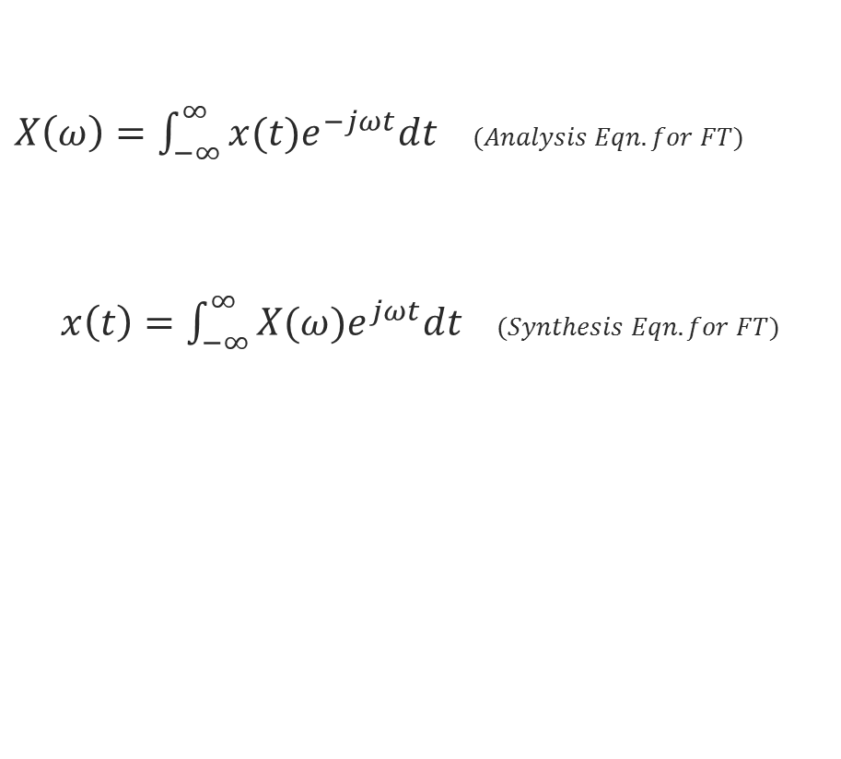
$X\left(ω\right)=\int_{−∞}^{∞}{x(t)e^{−jωt}dt}$ $(Analysis Eqn. for FT)$
$x\left(t\right)=\int_{−∞}^{∞}{X(ω)e^{jωt}dt}$ $(Synthesis Eqn. for FT)$
Copyright 2012 | Instructor: Dr. Gülden Köktürk | EED1004-INTRODUCTION TO SIGNAL PROCESSING

Slide 18
Copyright 2012 | Instructor: Dr. Gülden Köktürk | EED1004-INTRODUCTION TO SIGNAL PROCESSING

Slide 19
Copyright 2012 | Instructor: Dr. Gülden Köktürk | EED1004-INTRODUCTION TO SIGNAL PROCESSING

