Slide 1
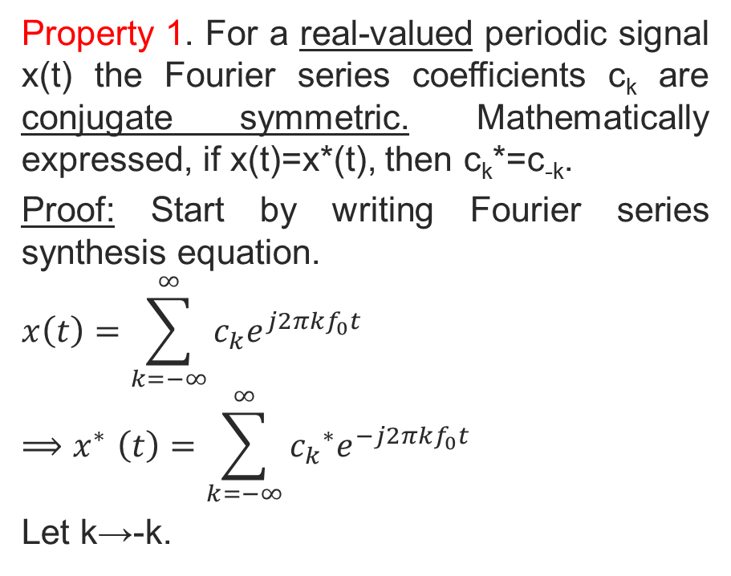
Symmetry Properties of Fourier Series
Property 1. For a real-valued periodic signal x(t) the Fourier series coefficients c_{k} are conjugate symmetric. Mathematically expressed, if x(t)=x*(t), then c_{k}*=c_{-k}.
Proof: Start by writing Fourier series synthesis equation.
$$x\left(t\right)=\sum_{k=−∞}^{∞}{{c_{k}e}^{j2πkf_{0}t}}$$
$${⟹x}^{∗}\left(t\right)=\sum_{k=−∞}^{∞}{{{c_{k}}^{∗}e}^{−j2πkf_{0}t}}$$
Let k→-k.
Copyright 2012 | Instructor: Dr. Gülden Köktürk | EED1004-INTRODUCTION TO SIGNAL PROCESSING

Slide 2
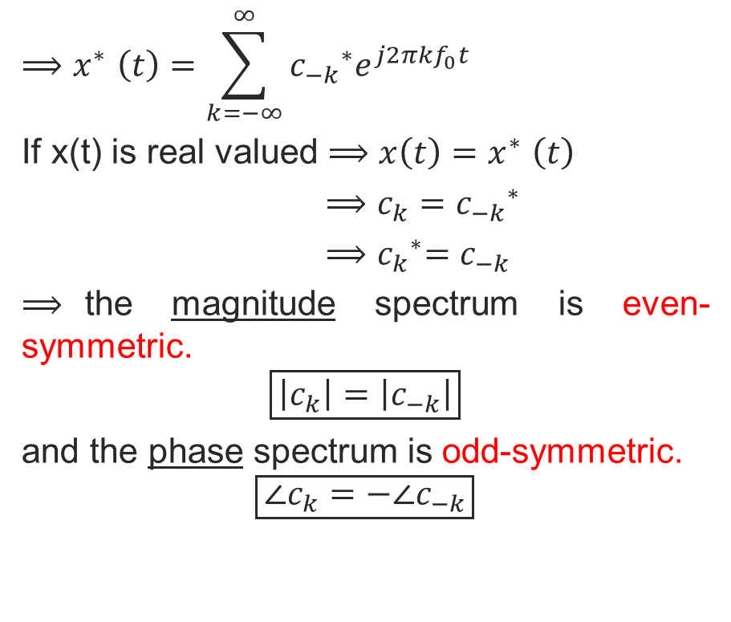
$${⟹x}^{∗}\left(t\right)=\sum_{k=−∞}^{∞}{{{c_{−k}}^{∗}e}^{j2πkf_{0}t}}$$
If x(t) is real valued ${⟹x\left(t\right)=x}^{∗}\left(t\right)$
${{⟹c_{k}=c}_{−k}}^{∗}$
${⟹c_{k}}^{∗}=c_{−k}$
$⟹$the magnitude spectrum is even-symmetric.
$$\boxed{\left|c_{k}\right|=\left|c_{−k}\right|}$$
and the phase spectrum is odd-symmetric.
$$\boxed{∠c_{k}=−∠c_{−k}}$$
Copyright 2012 | Instructor: Dr. Gülden Köktürk | EED1004-INTRODUCTION TO SIGNAL PROCESSING

Slide 3

Property 2. For a real-valued and even-symmetric periodic signal x(t), the Fourier series coefficients c_{k} are purely real. Mathematically expressed, if x(t)=x*(t)=x(-t), then
${{c_{k}=c}_{k}}^{∗}$
$$x\left(t\right)=\sum_{k=−∞}^{∞}{{c_{k}e}^{j2πkf_{0}t}}⟹x\left(−t\right)=\sum_{k=−∞}^{∞}{{c_{k}e}^{−j2πkf_{0}t}}$$
$$x^{∗}\left(t\right)=\sum_{k=−∞}^{∞}{{{c_{k}}^{∗}e}^{−j2πkf_{0}t}}⟹\boxed{{{c_{k}=c}_{k}}^{∗}}$$
c_{k} are purely real (imaginary parts of c_{k} are equal to 0).
Copyright 2012 | Instructor: Dr. Gülden Köktürk | EED1004-INTRODUCTION TO SIGNAL PROCESSING

Slide 4
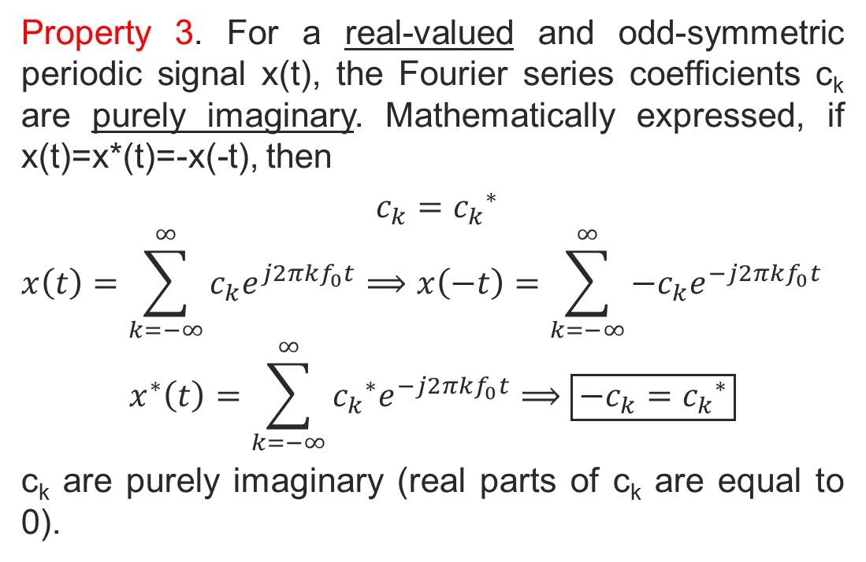
Property 3. For a real-valued and odd-symmetric periodic signal x(t), the Fourier series coefficients c_{k} are purely imaginary. Mathematically expressed, if x(t)=x*(t)=-x(-t), then
${{c_{k}=c}_{k}}^{∗}$
$$x\left(t\right)=\sum_{k=−∞}^{∞}{{c_{k}e}^{j2πkf_{0}t}}⟹x\left(−t\right)=\sum_{k=−∞}^{∞}{−{c_{k}e}^{−j2πkf_{0}t}}$$
$$x^{∗}\left(t\right)=\sum_{k=−∞}^{∞}{{{c_{k}}^{∗}e}^{−j2πkf_{0}t}}⟹\boxed{−{{c_{k}=c}_{k}}^{∗}}$$
c_{k} are purely imaginary (real parts of c_{k} are equal to 0).
Copyright 2012 | Instructor: Dr. Gülden Köktürk | EED1004-INTRODUCTION TO SIGNAL PROCESSING

